Slide 1
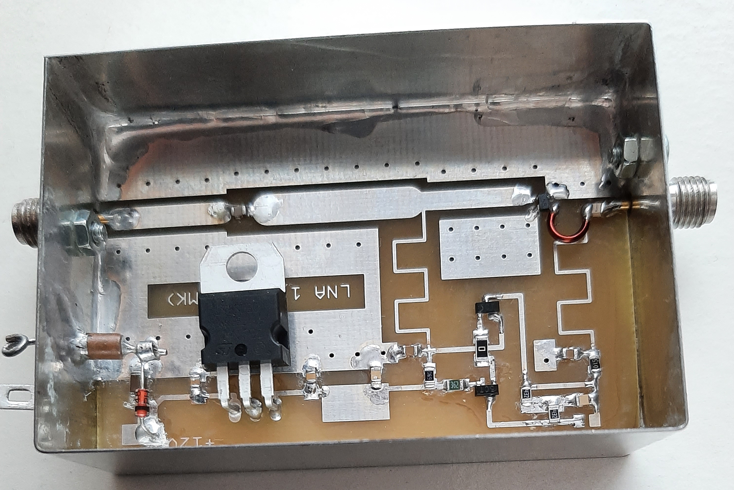
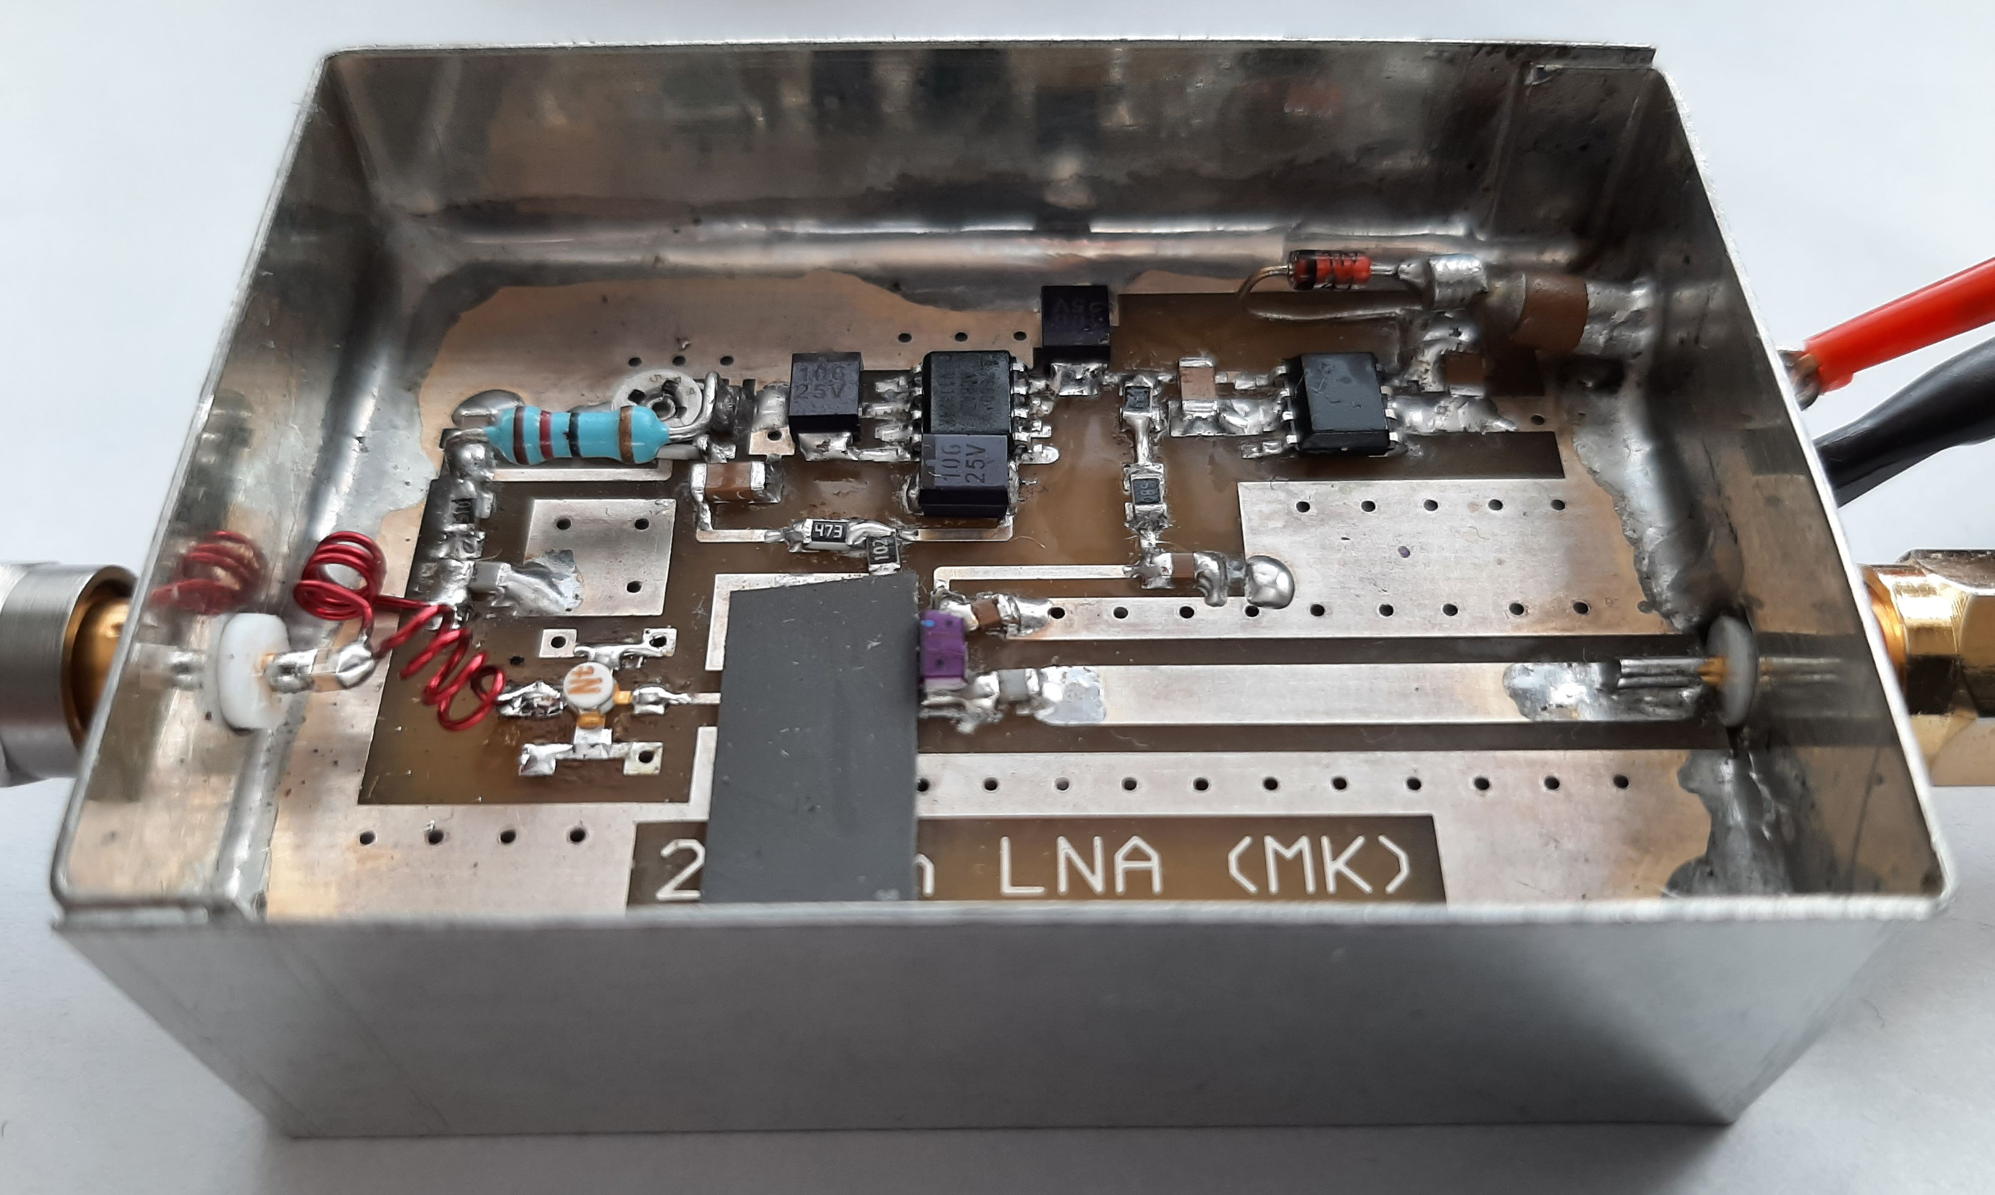
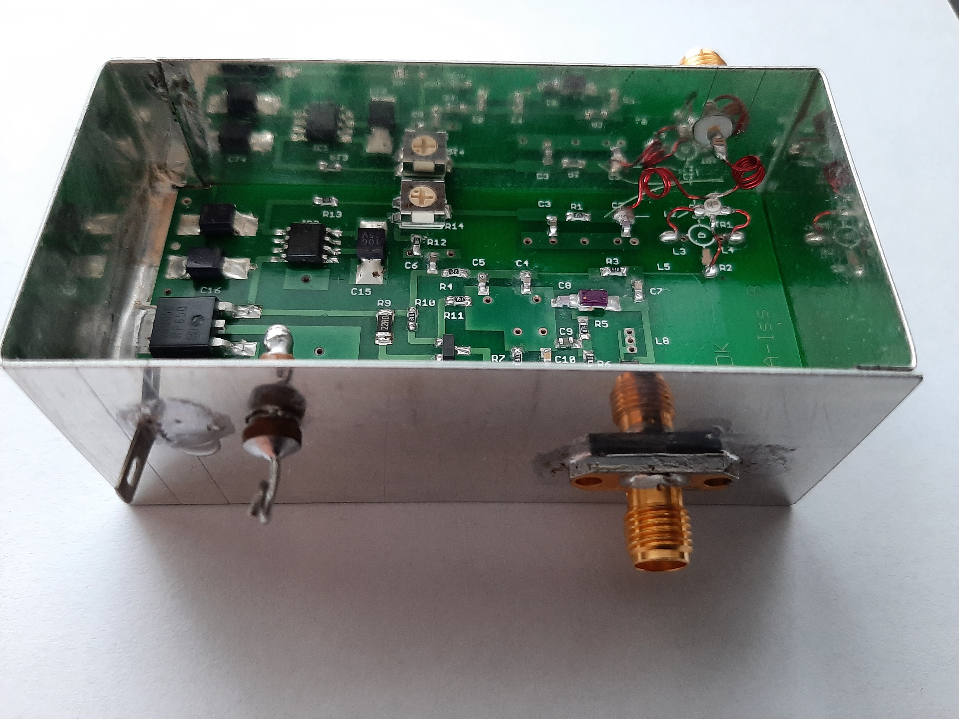
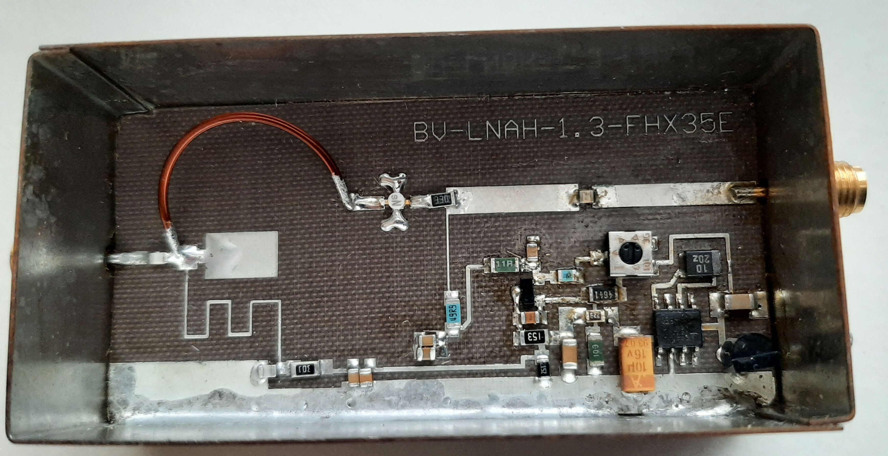
VLNA notes
Mirek Kasal, OK2AQ
33rd EME a MW seminar, Radešín 2024

Slide 2
MOTIVACE
- zhoršení N.F. LNA pro 23 cm z 0,3 na 0,7 dB
- problém výběru aktivního prvku pro 1.stupeň
- zpřesněný vlastní návrh LNA
33rd EME a MW seminar, Radešín 2024

Slide 3
HEMTs
MGF4919G
NE32584, NE3511S02, NE3515S02, ATF36077, ATF35143
ATF 54143, CE3512K2, CE3520K3, atd.
MMICs
SAV-581+, PMA2-33LN+, SKY67151-396LF, TSY-83LN+ atd.
33rd EME a MW seminar, Radešín 2024

Slide 4
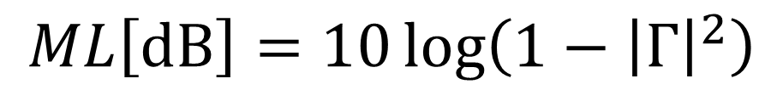
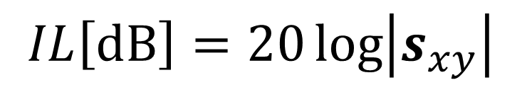
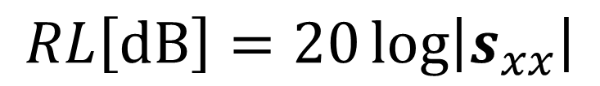
$$RL\left[dB\right]=20\log\left|s_{xx}\right|$$
$$IL\left[dB\right]=20\log\left|s_{xy}\right|$$
$$ML\left[dB\right]=10\log\left(1−{\left|Γ\right|}^{2}\right)$$
33rd EME a MW seminar, Radešín 2024

Slide 5
MGF4919G
33rd EME a MW seminar, Radešín 2024

Slide 6
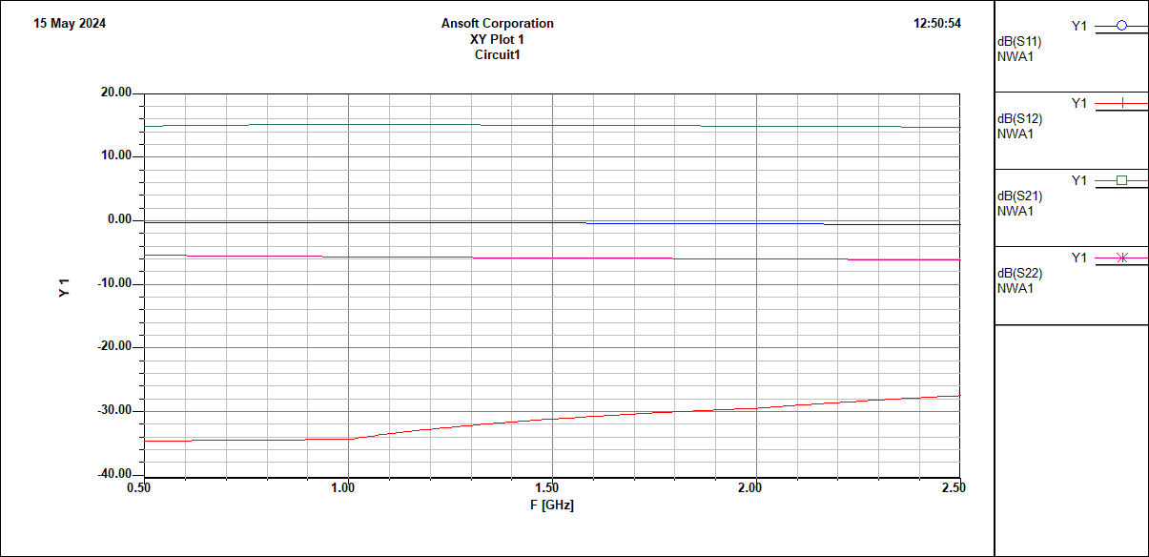
33rd EME a MW seminar, Radešín 2024

Slide 7
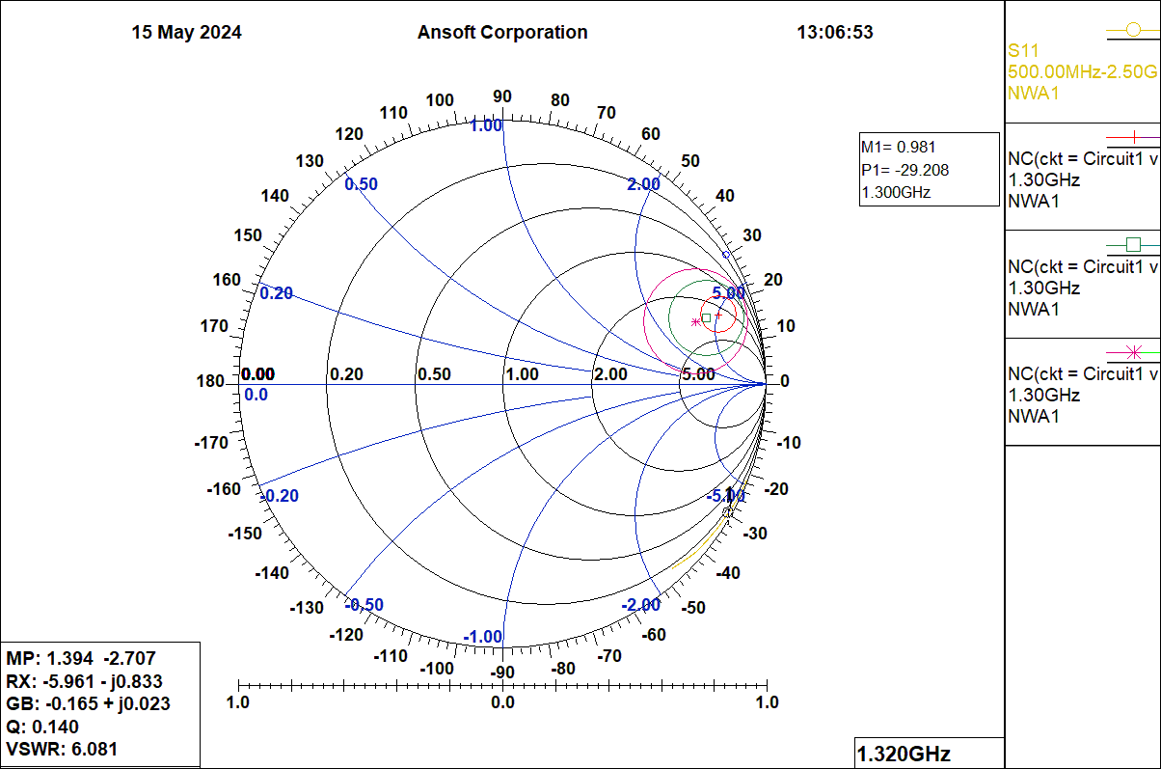
33rd EME a MW seminar, Radešín 2024

Slide 8
33rd EME a MW seminar, Radešín 2024

Slide 9
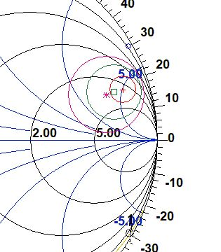
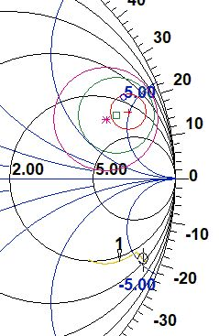

S₁₁*
$$Γ_{opt}$$
S₁₁
33rd EME a MW seminar, Radešín 2024

Slide 10
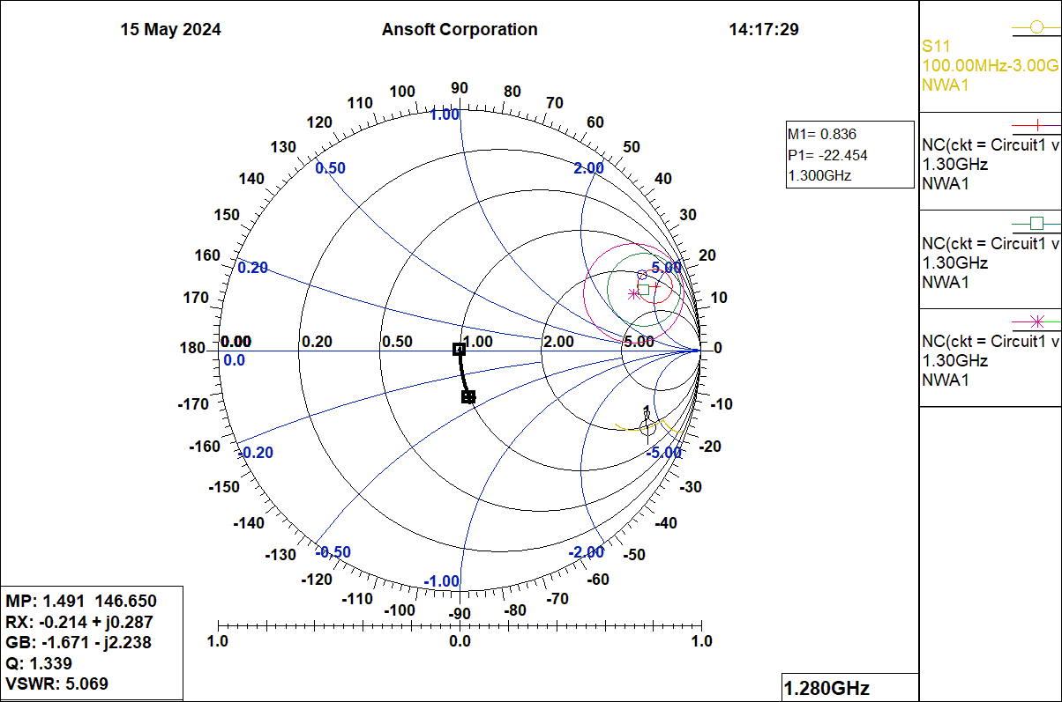
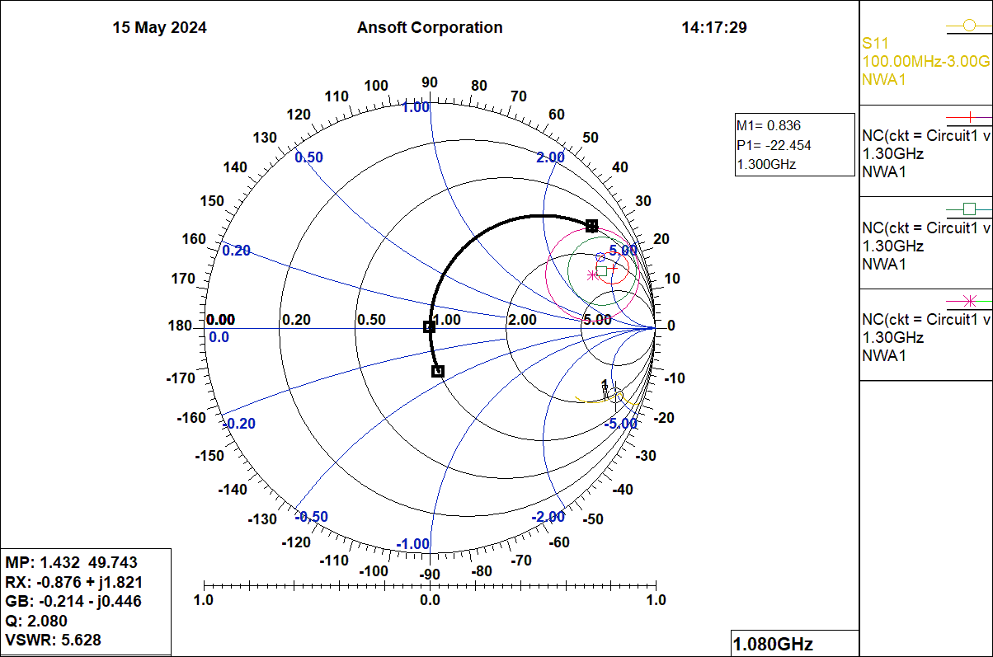
33rd EME a MW seminar, Radešín 2024

Slide 11

Open Stub
50 Ω|6 deg
22 nH
6pF

Slide 12
33rd EME a MW seminar, Radešín 2024

Slide 13
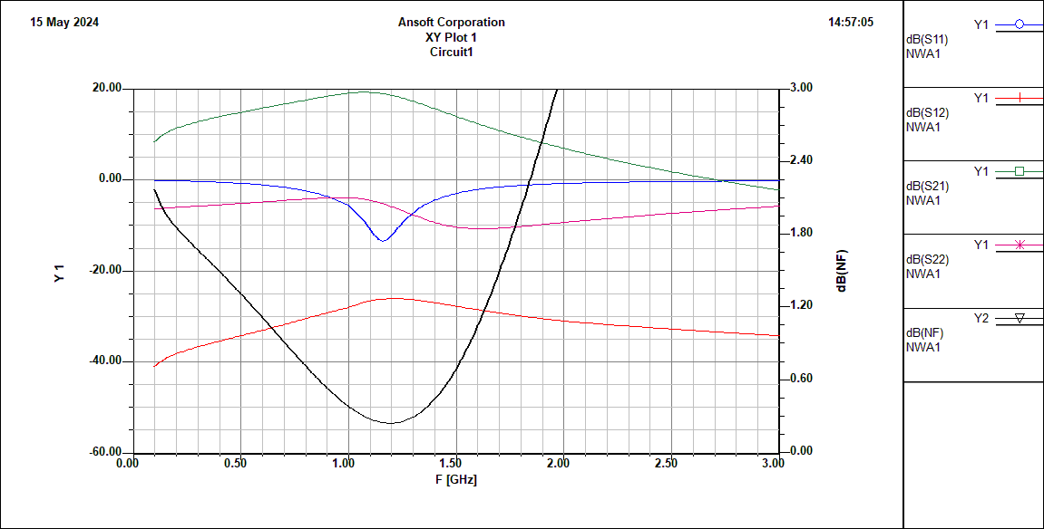
33rd EME a MW seminar, Radešín 2024

Slide 14
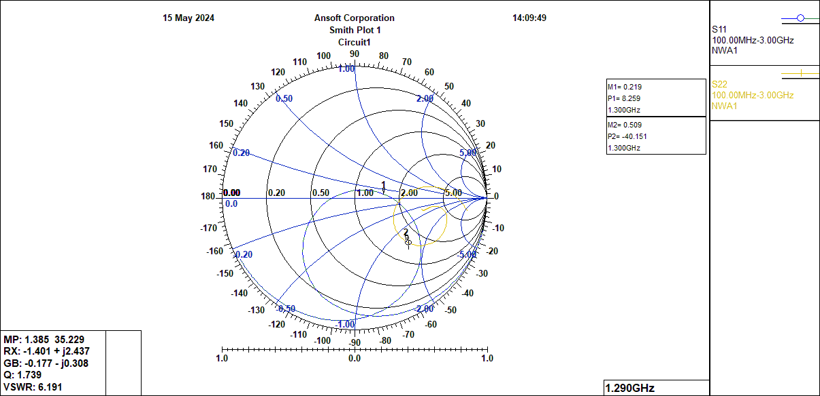
33rd EME a MW seminar, Radešín 2024

Slide 15
33rd EME a MW seminar, Radešín 2024

Slide 16
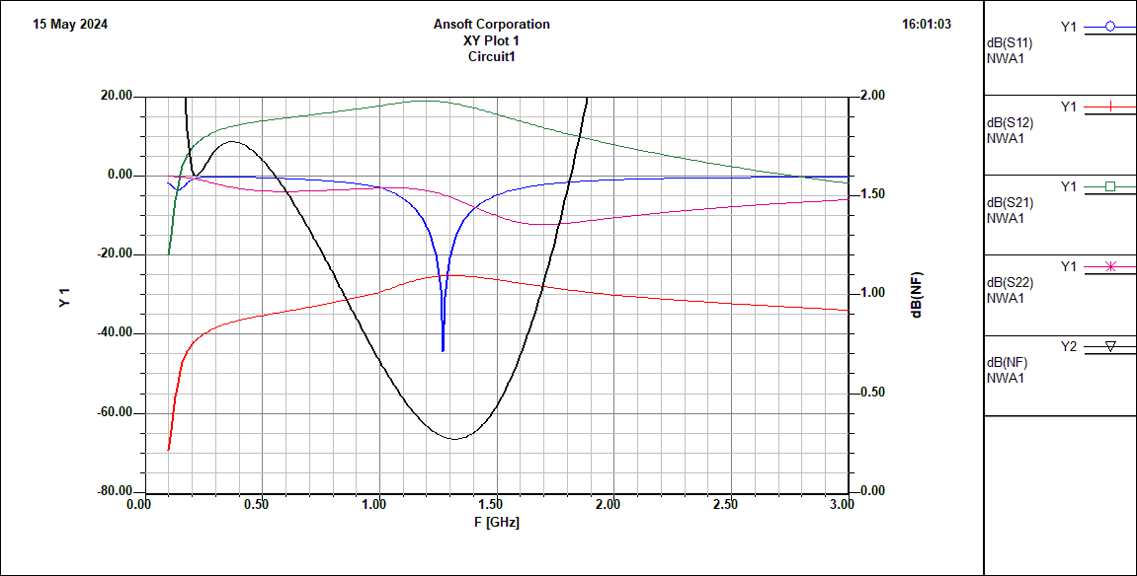
33rd EME a MW seminar, Radešín 2024

Slide 17
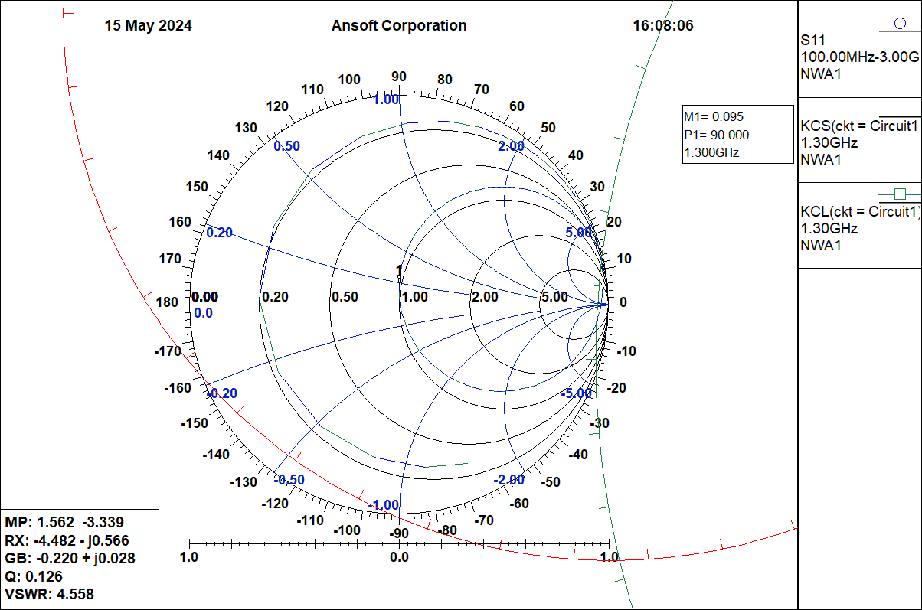
33rd EME a MW seminar, Radešín 2024

Slide 18
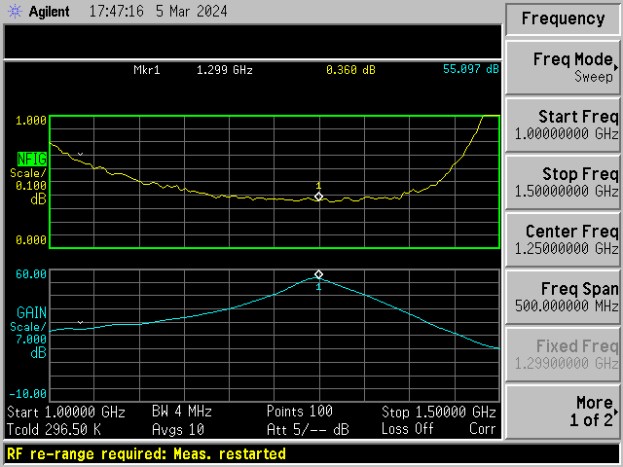
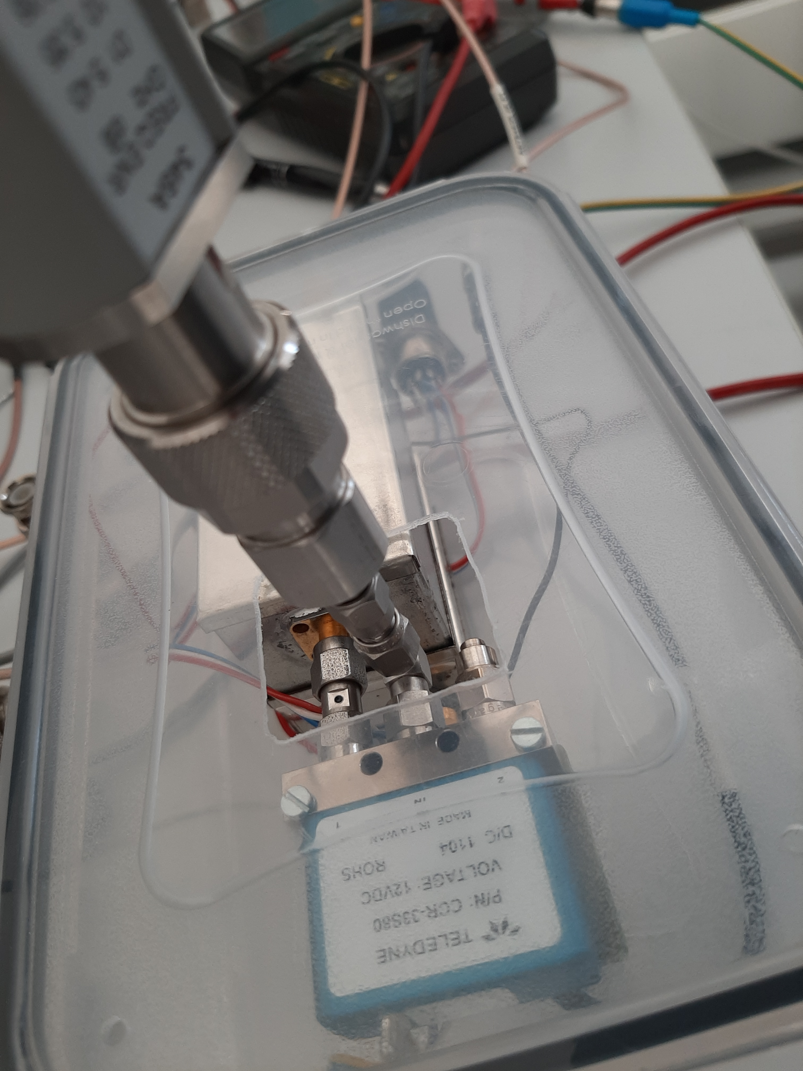
33rd EME a MW seminar, Radešín 2024

Slide 19
SAV-581 3 V, 30 mA E-PHEMT
33rd EME a MW seminar, Radešín 2024

Slide 20
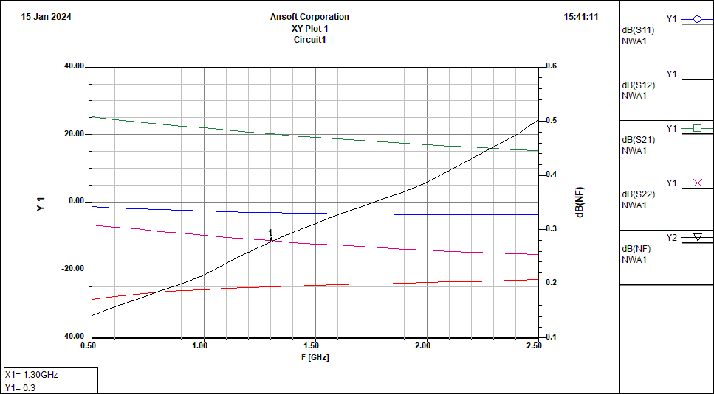
33rd EME a MW seminar, Radešín 2024

Slide 21
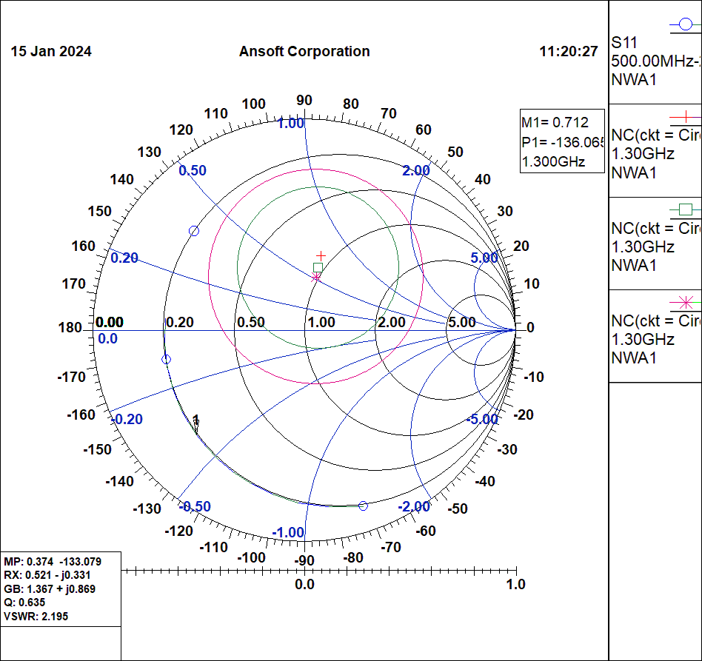

S₁₁*
$$Γ_{opt}$$
S₁₁
33rd EME a MW seminar, Radešín 2024

Slide 22
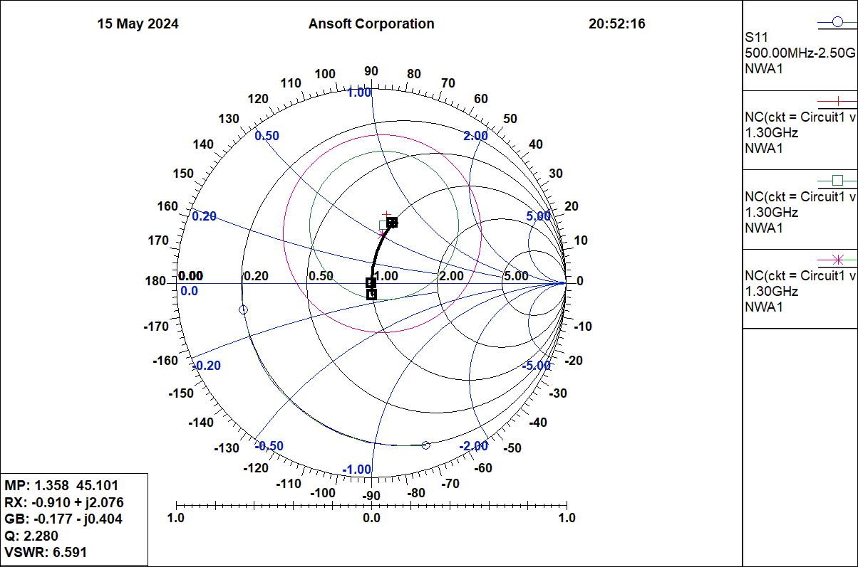
5 nH
20 pF
33rd EME a MW seminar, Radešín 2024

Slide 23
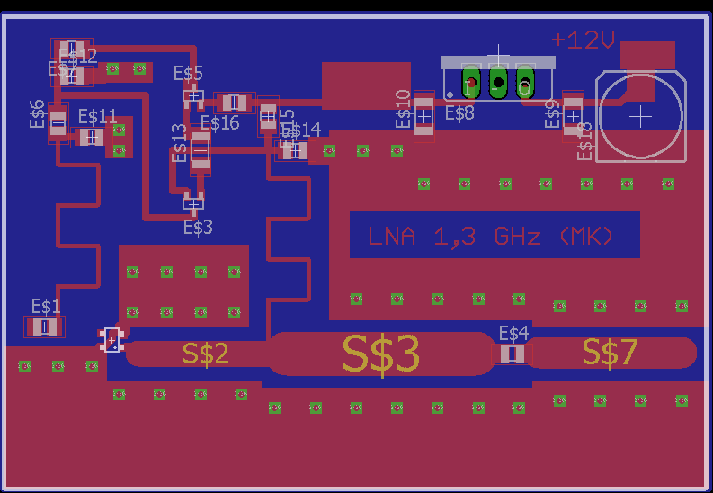
33rd EME a MW seminar, Radešín 2024

Slide 24
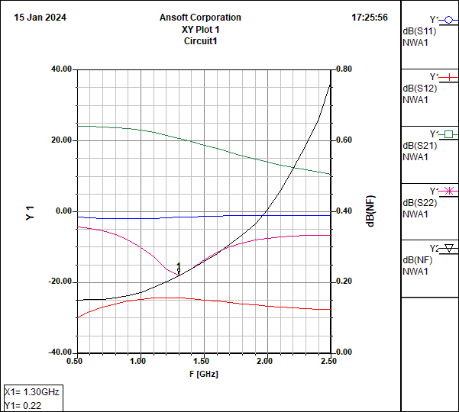
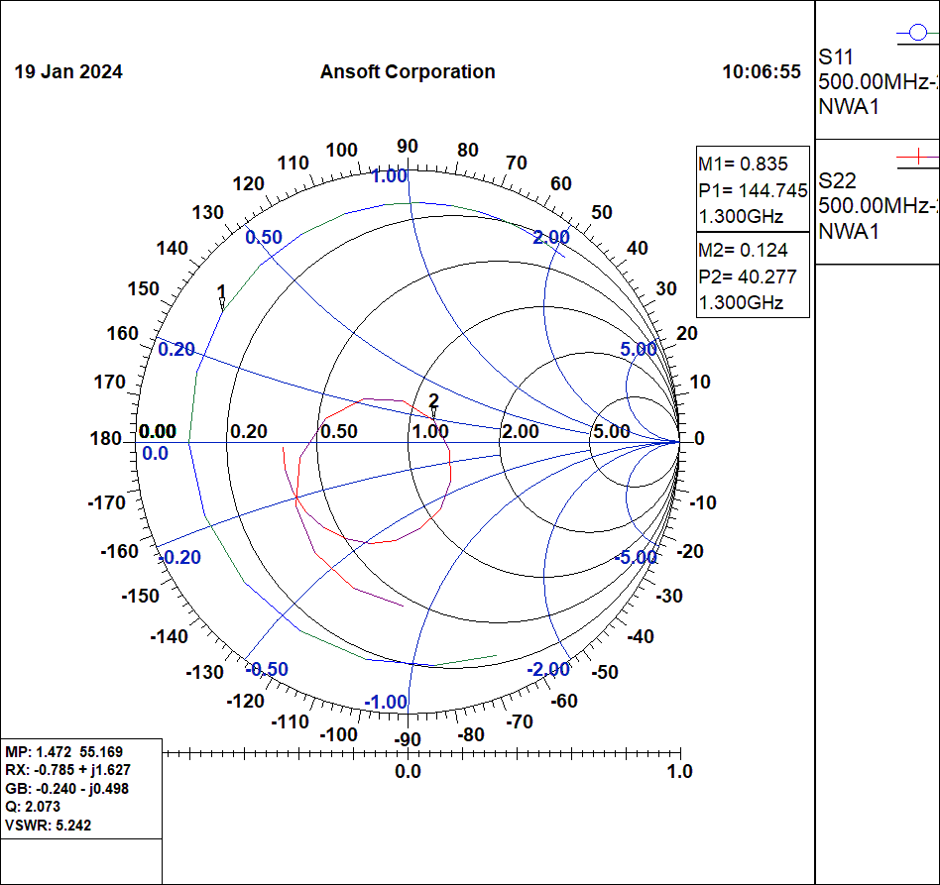
33rd EME a MW seminar, Radešín 2024

Slide 25
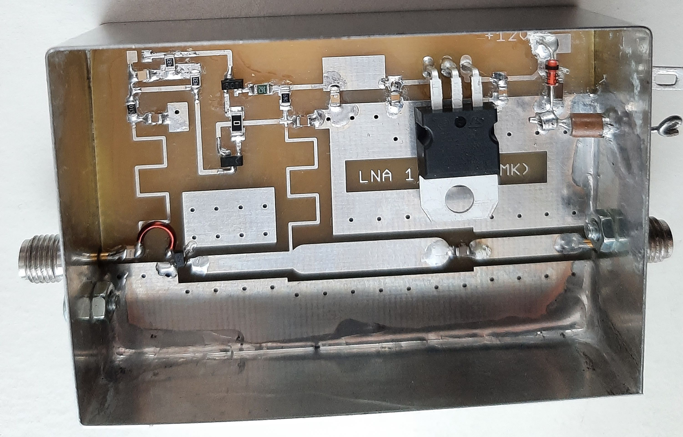
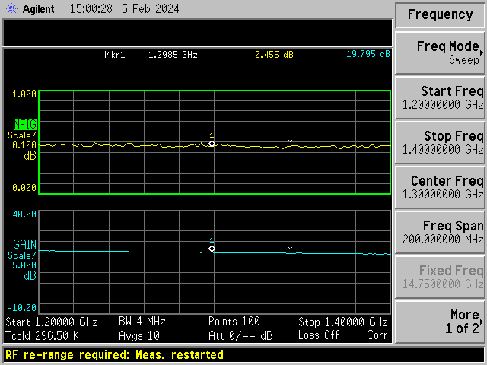
33rd EME a MW seminar, Radešín 2024

Slide 26
LNA s MMIC
SKYWORKS
SKY67151-396LF
33rd EME a MW seminar, Radešín 2024

Slide 27
DD1US:
33rd EME a MW seminar, Radešín 2024

Slide 28
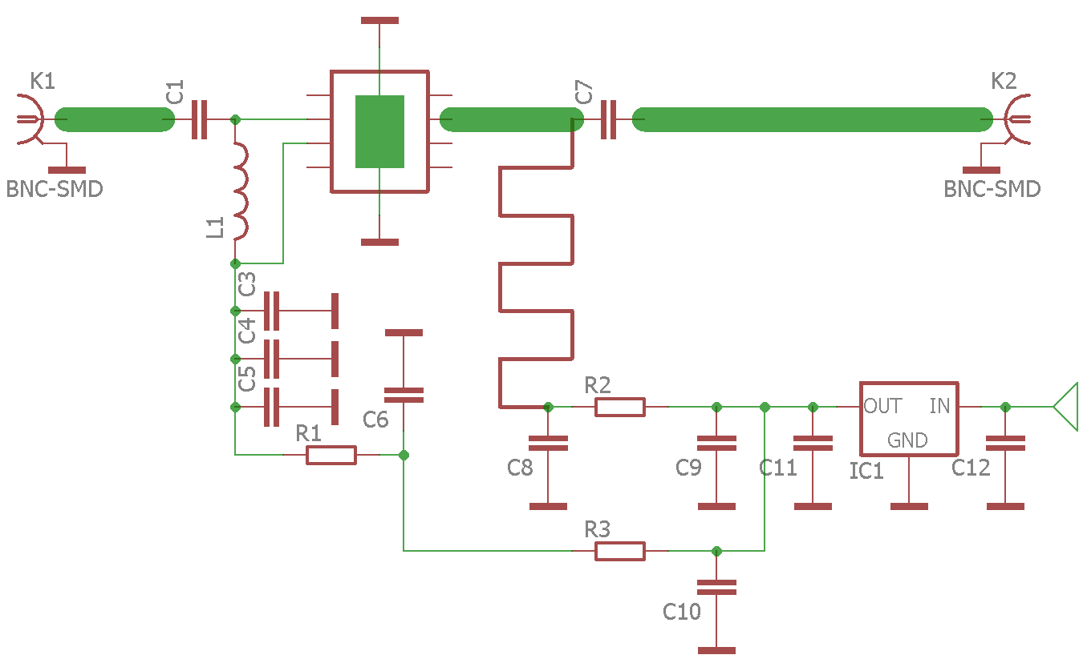
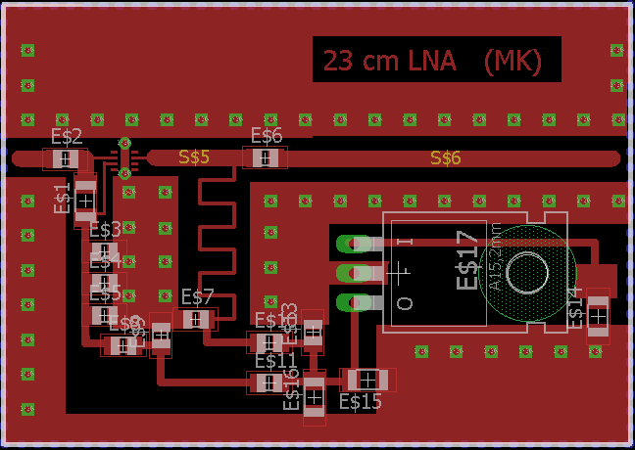
Pro terestrické závodníky:
TSY-83LN+
33rd EME a MW seminar, Radešín 2024

Slide 29
DĚKUJI VÁM ZA POZORNOST
THANK YOU FOR YOUR ATTENTION
33rd EME a MW seminar, Radešín 2024

