Slide 1
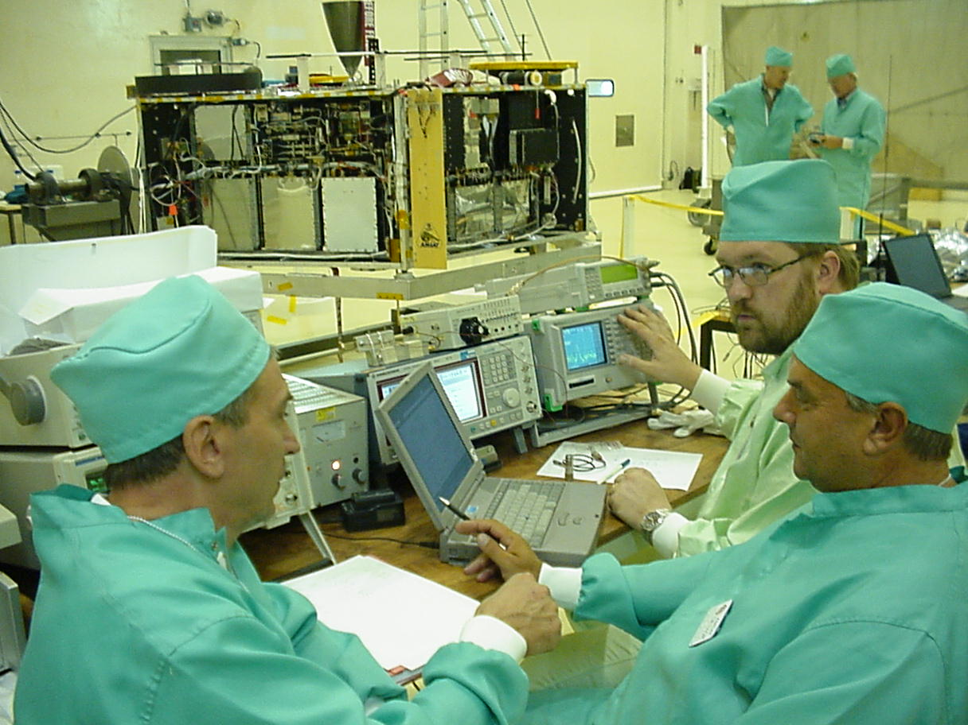
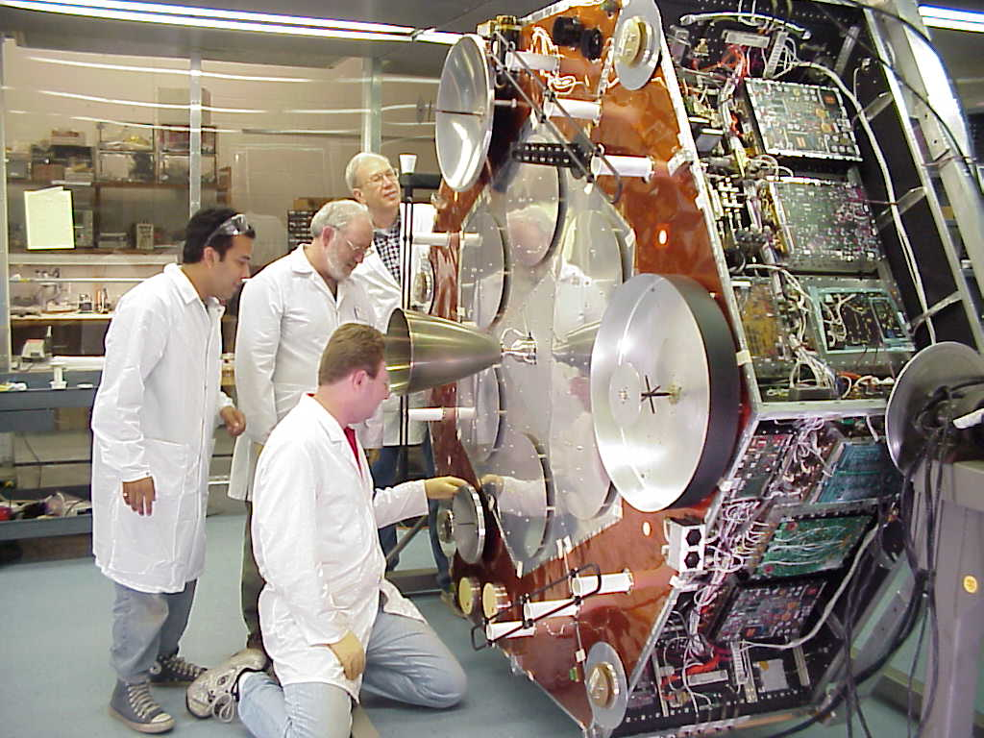
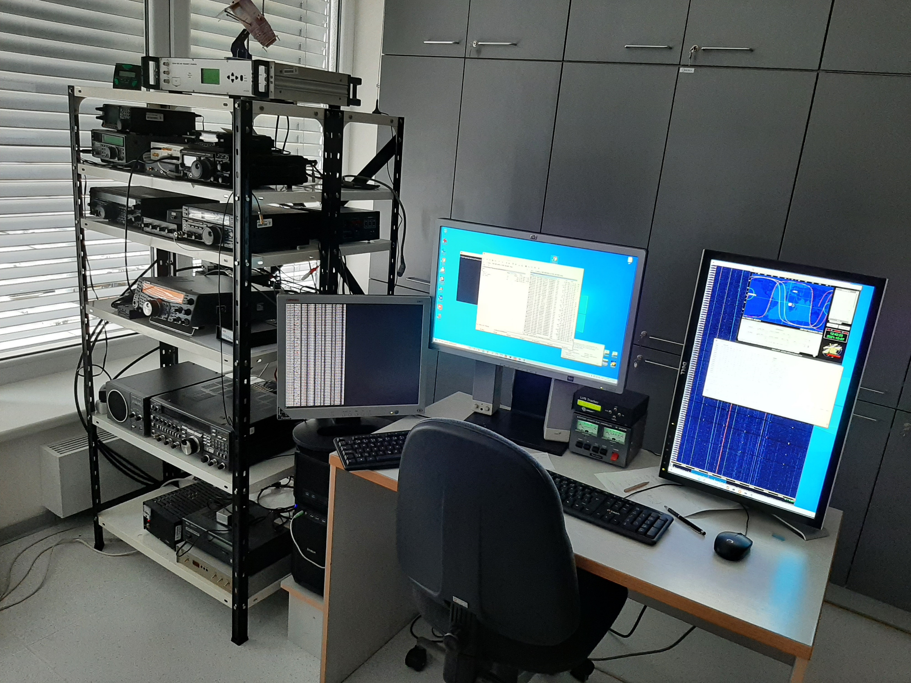
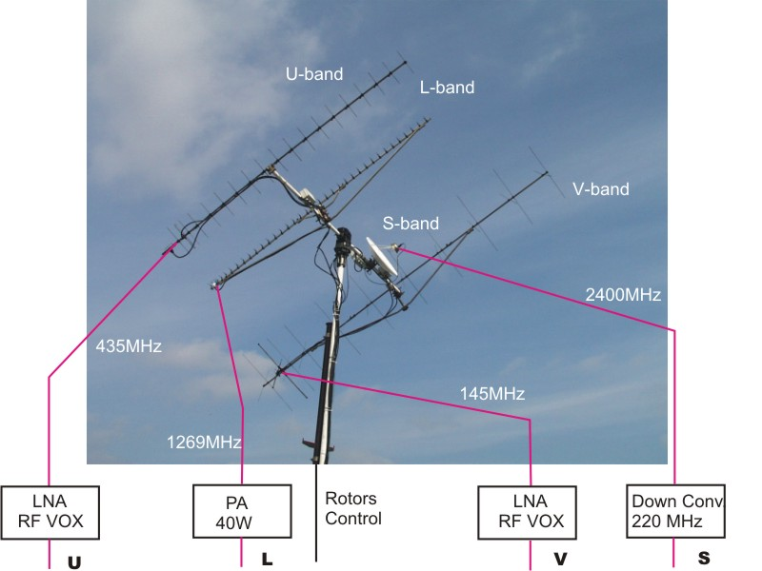
EXPERIMENTAL SATELLITE LABORATORY
DREL FEKT BUT
ESA Centre Spatiale Guyanais
Kourou 2000
PIIID Satellite launch campaign
with Ariane V rocket
ESL DREL FEKT BUT 2000 -2005
Ground segment
Telemetry gathering and statellite control
AMSAT Phase IIID Satellite
University Marburg 1995 - 1999
AMSAT Facility Orlando FL 1997 - 2000
ESL Brno 1994 - 2000
Design and realization of L-band receivers,
Satellite integration

Slide 2
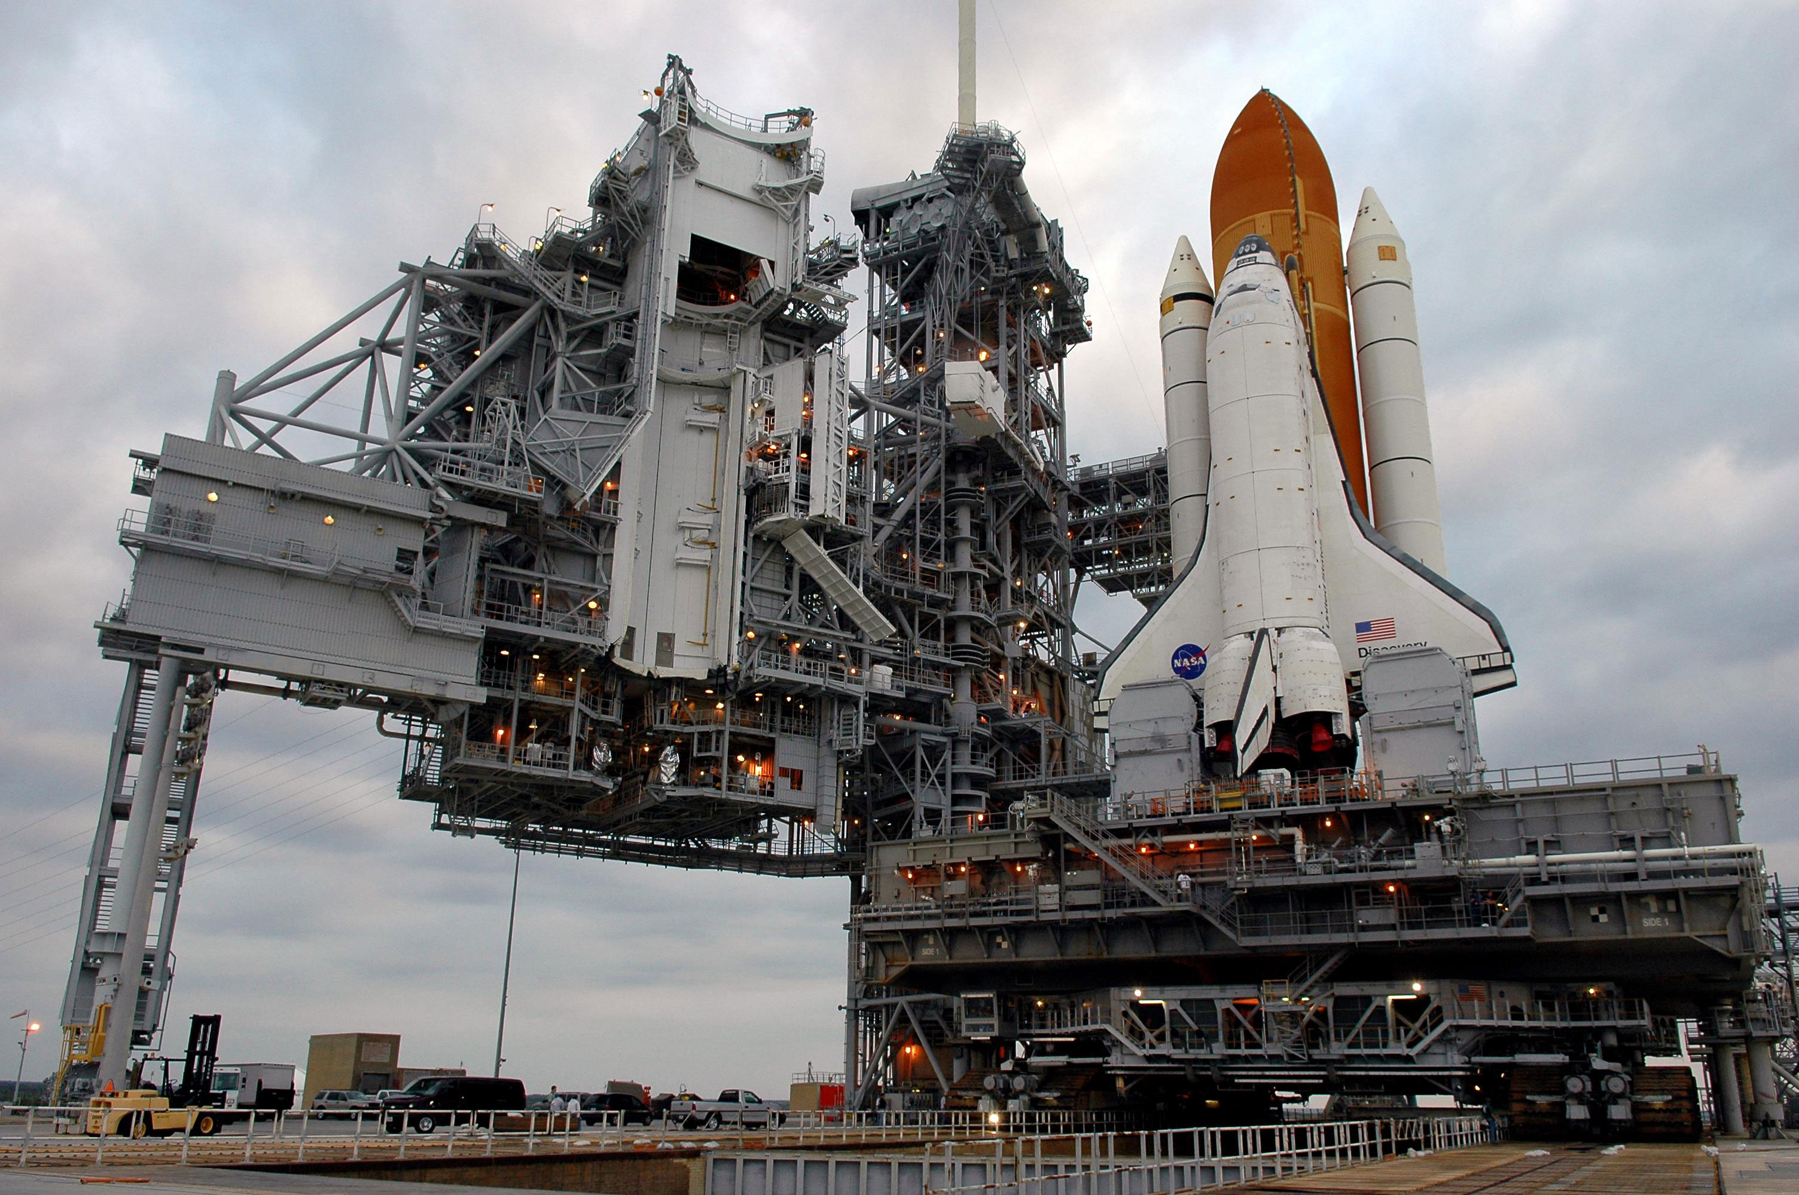
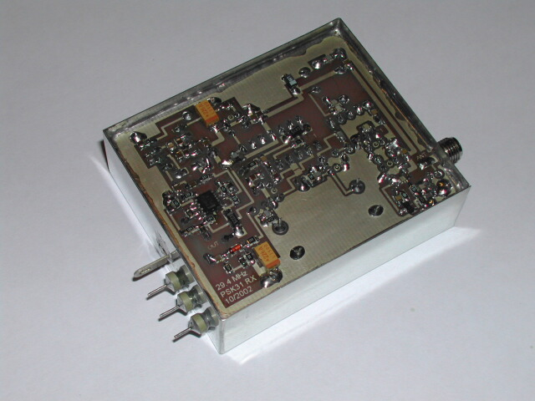
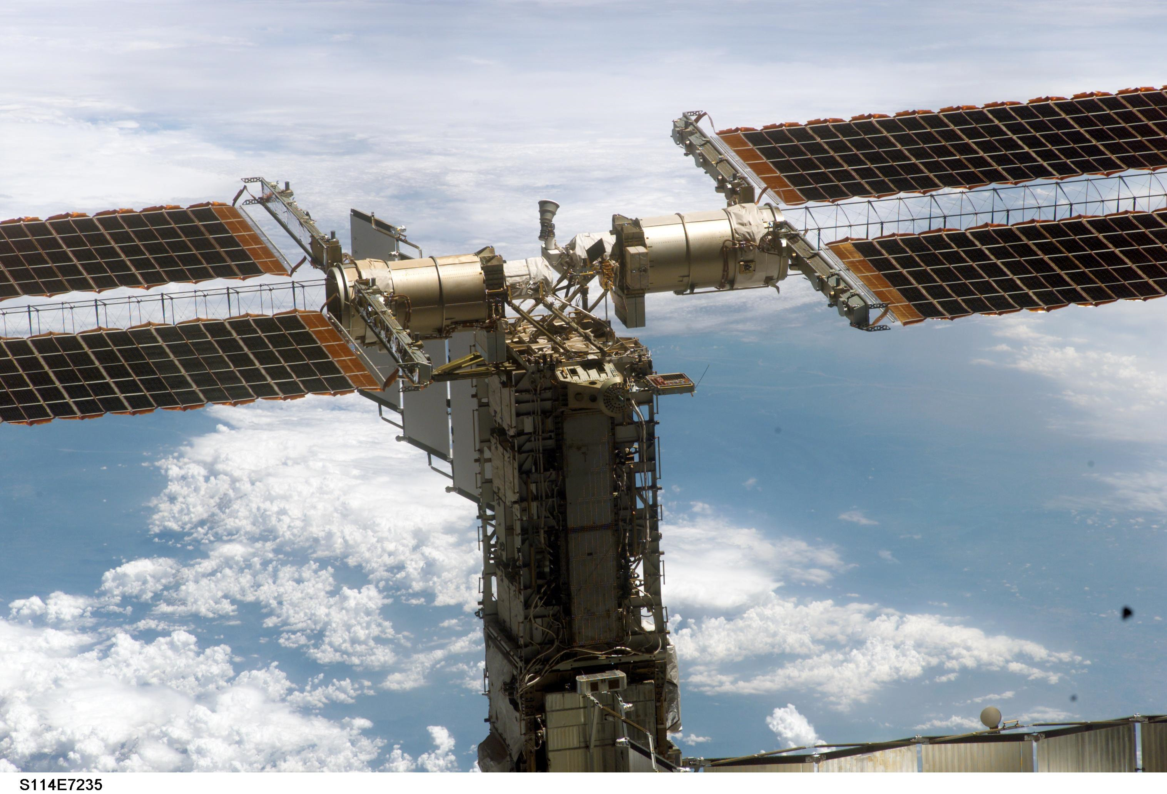
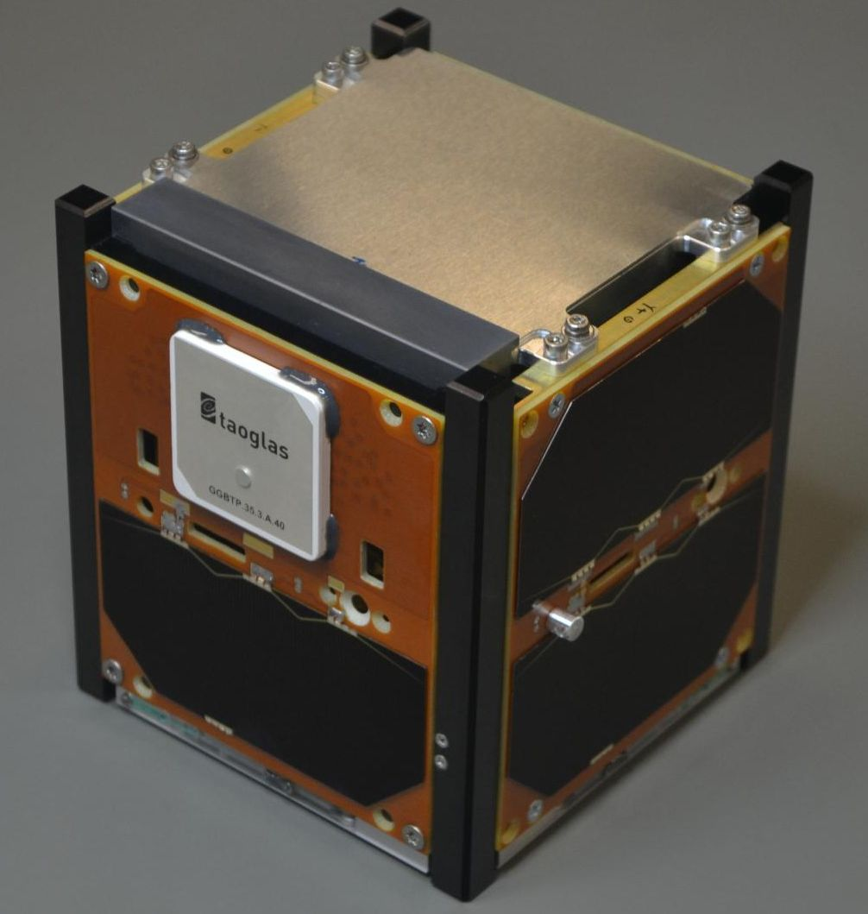
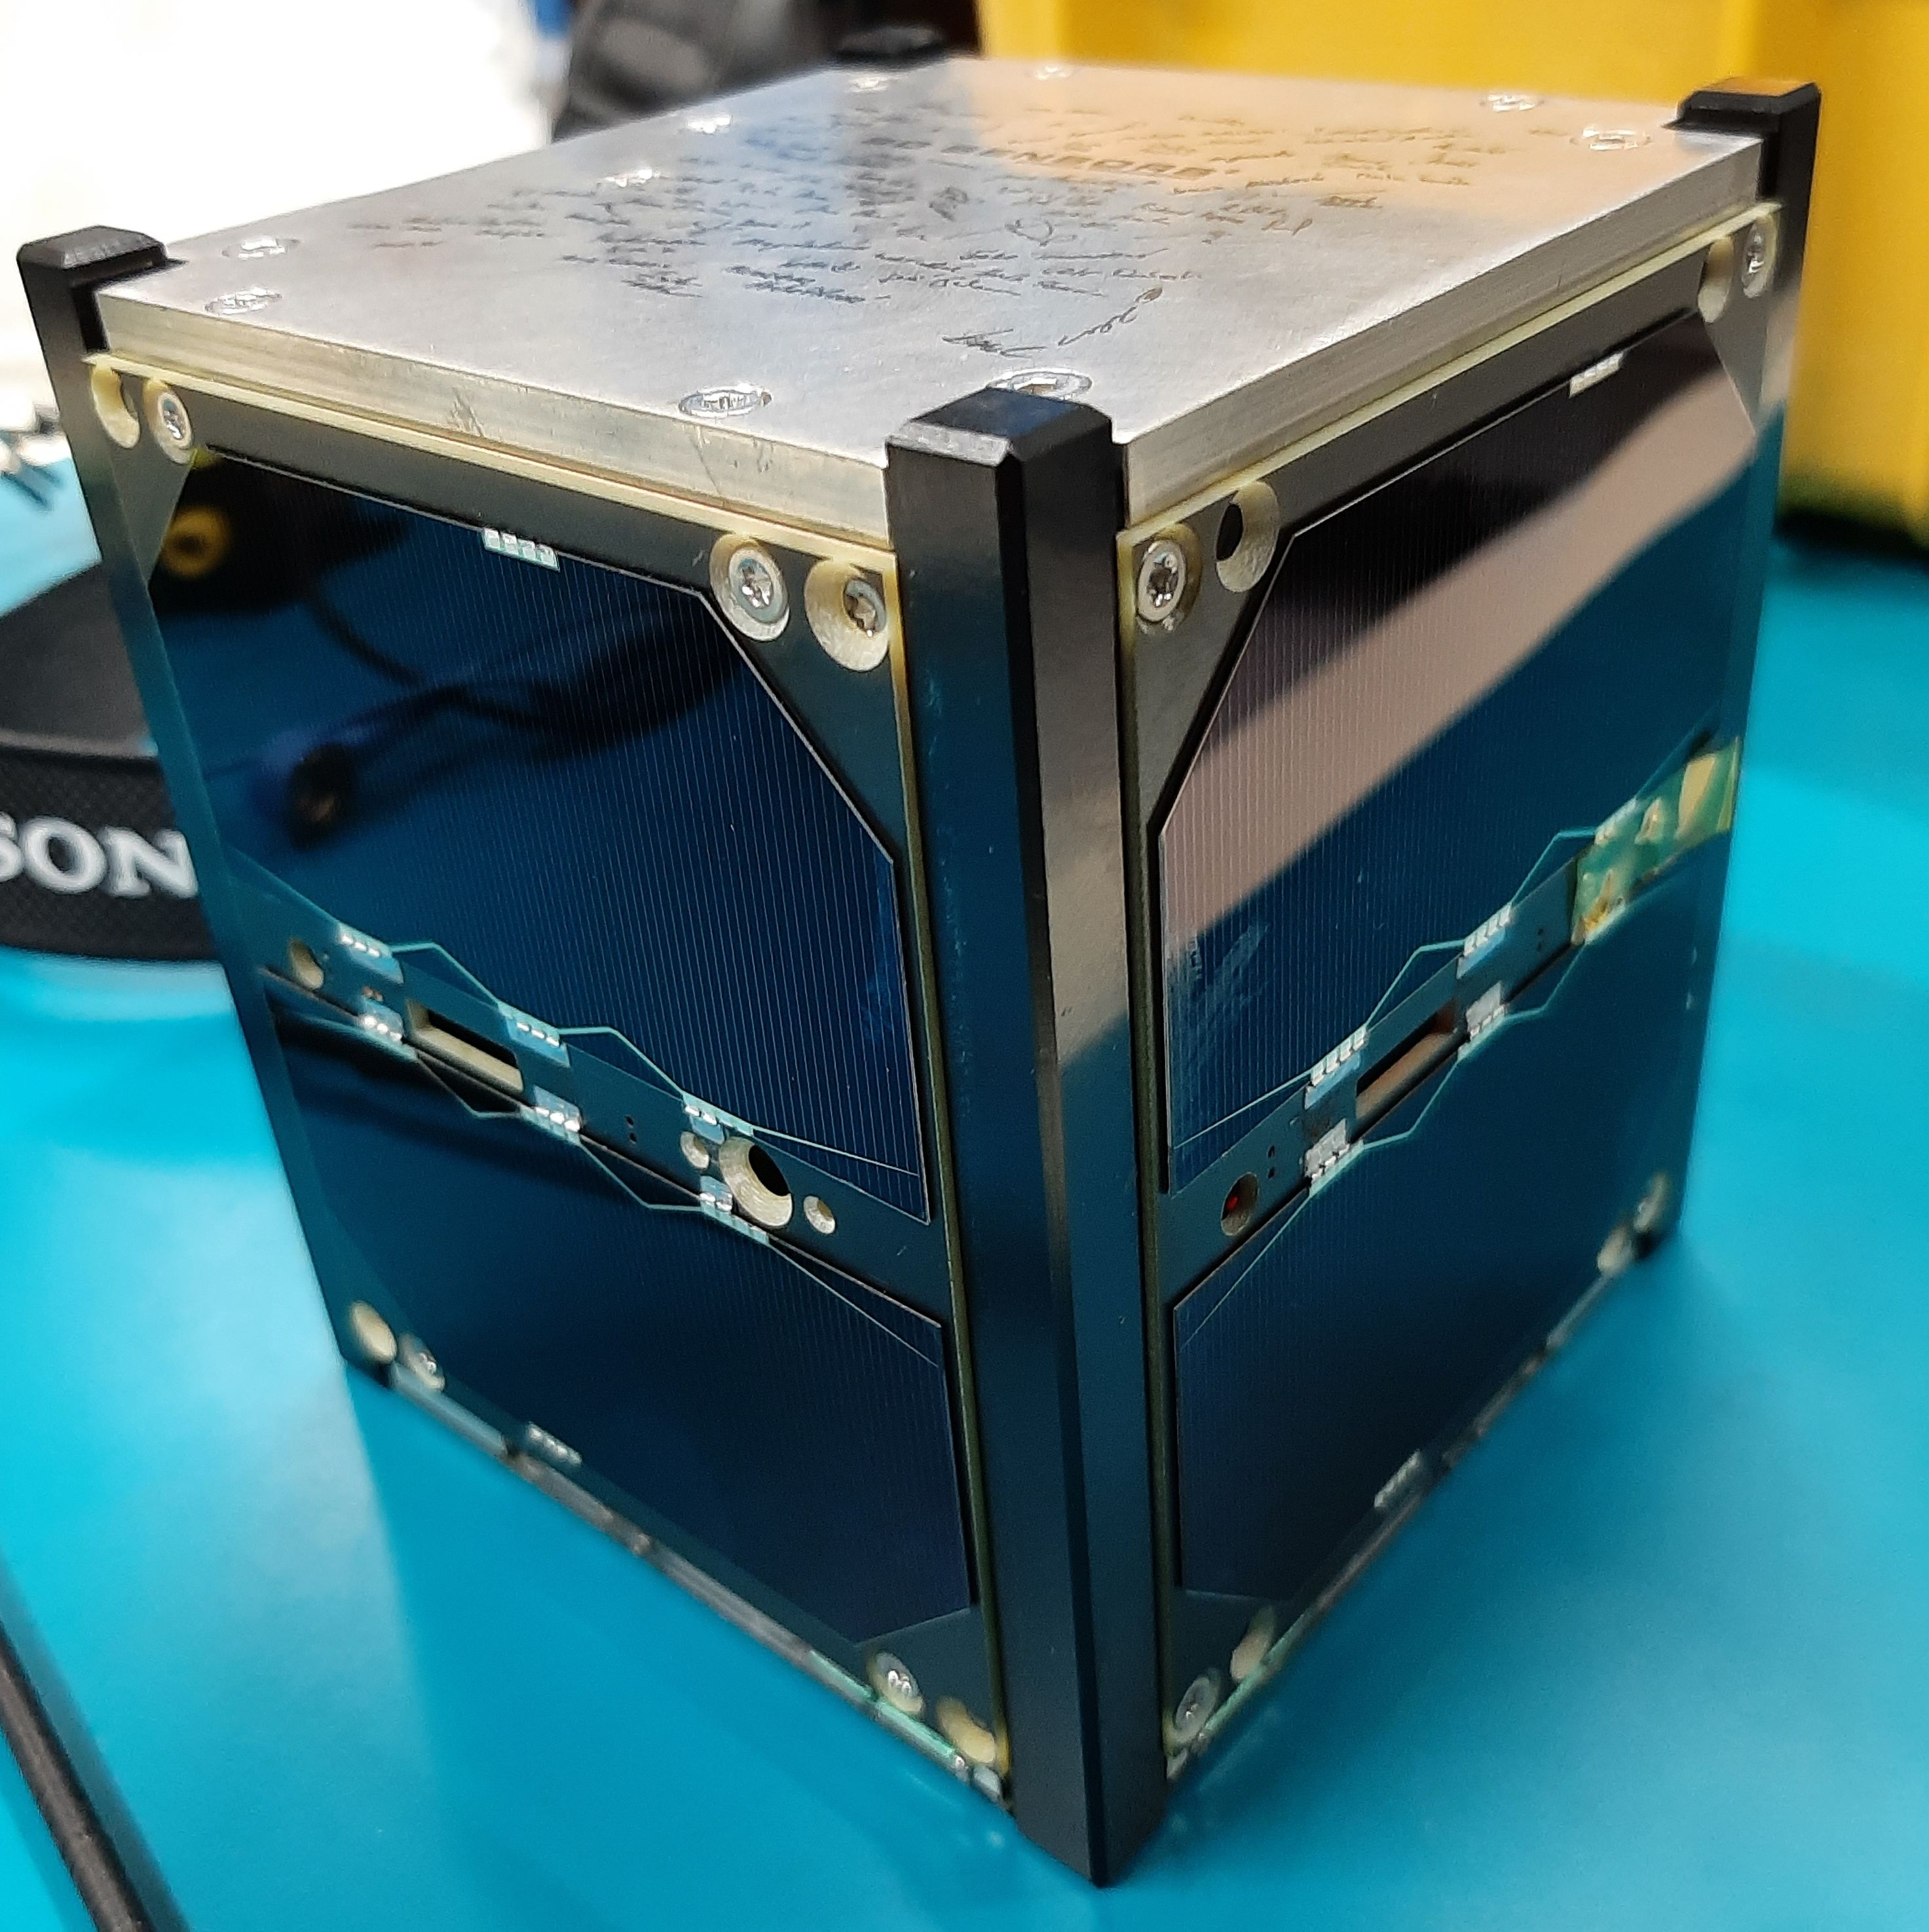
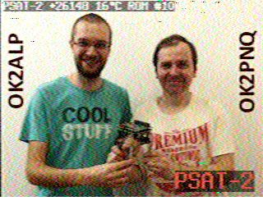
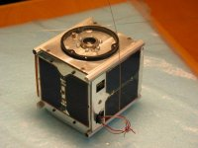
EXPERIMENTAL SATELLITE LABORATORY
DREL FEKT BUT
US Naval Academy & ESL - PCSAT2 2005
PCSAT 2
US Naval Academy & ESL
PSAT 2015
BriSat 2015
Psat-2 2019
GRBAlpha BDSat
ESL – Ground Segment 2021 – 2022

