Slide 1
Wireless Communication: Maxwell Equations & Solution
Body-centric wireless communication
Zbyněk Raida
raida@vut.cz
Vytvořeno za podpory projektu OP VVV Moderní a otevřené studium techniky CZ.02.2.69/0.0/0.0/16_015/0002430

Slide 2
Contents
Electromagnetic (EM) wave and the description [Maxwell equations → wave equation]
Finite-difference method [CST Microwave Studio]
Finite-element method [HFSS]

Slide 3
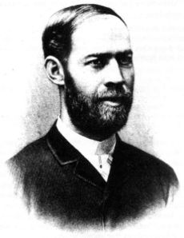
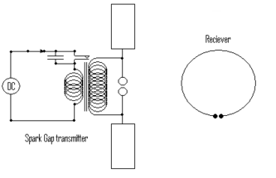
Electromagnetic wave
Wireless transmission of information
1887 Heinrich Rudolf Hertz

Slide 4
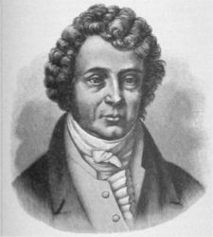
Electromagnetic wave
Alternate current → magnetic field
André-Marie Ampère
magnetic field intensity [A/m]
electric field intensity [V/m]

Slide 5
Electromagnetic wave

Slide 6
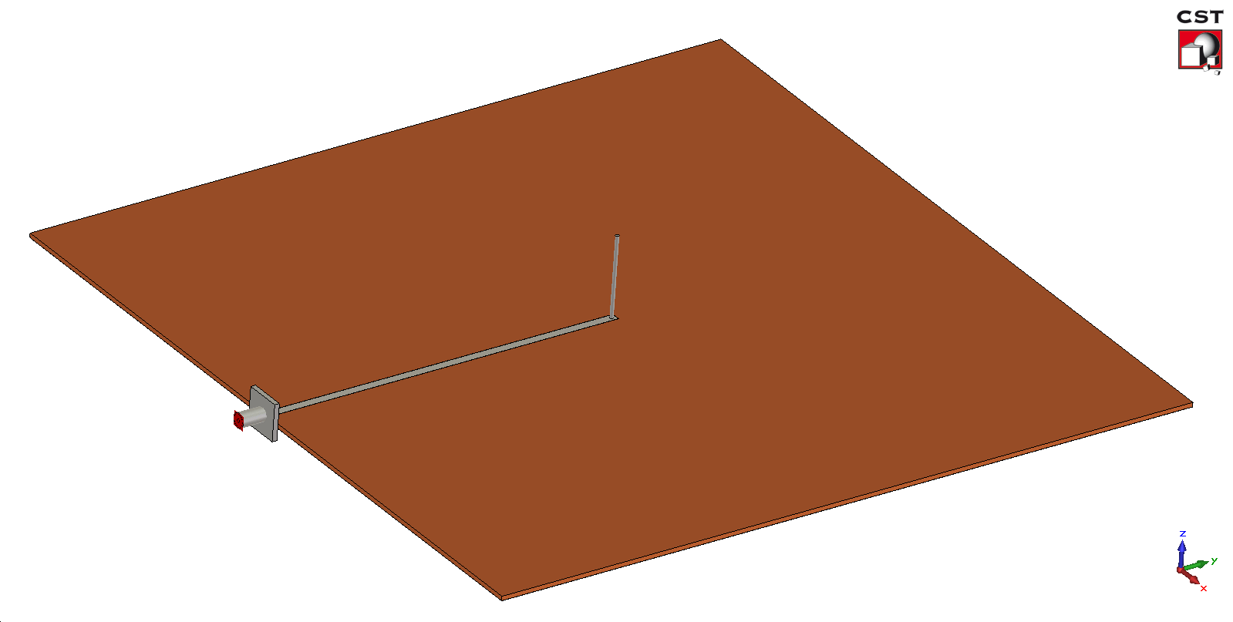
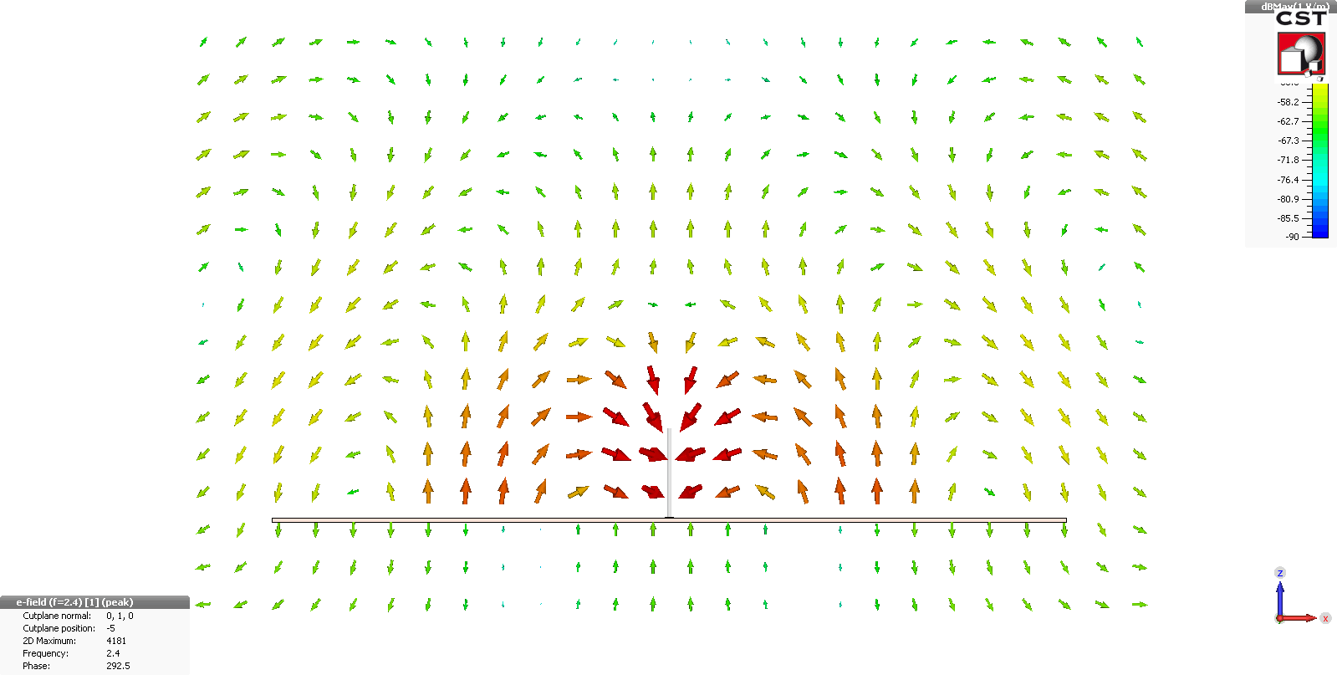
Electromagnetic wave

Slide 7
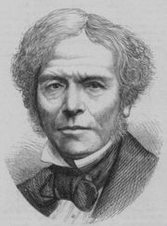
Electromagnetic wave
Magnetic flux → electric field
Michael Faraday
electric field intensity [V/m]
magnetic field intensity [A/m]

Slide 8
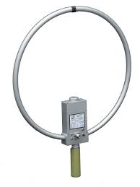
Electromagnetic wave

Slide 9
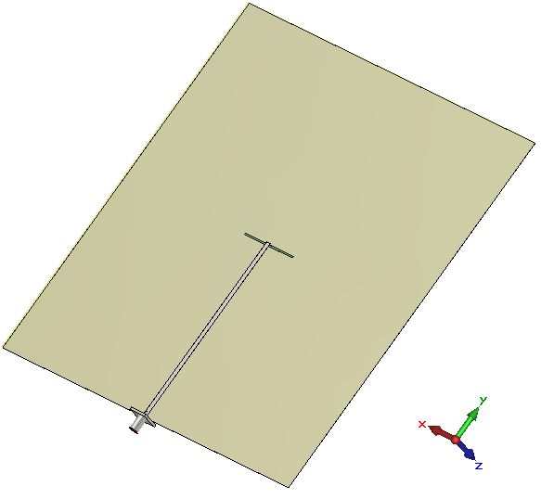
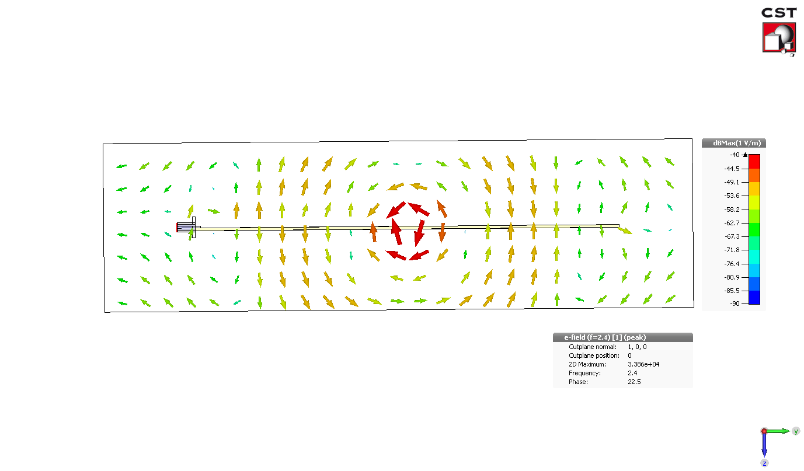
Electromagnetic wave

Slide 10
Maxwell equations

Slide 11
Maxwell: integral × differential
∇

Slide 12
Maxwell: frequency domain
complex permittivity

Slide 13
Maxwell: wave equations
Wave equations
Wave number
Lossless environment

Slide 14
Maxwell: wave equations
planar wavefront

Slide 15
Maxwell: wave equations
Solution:
Boundary conditions:

Slide 16
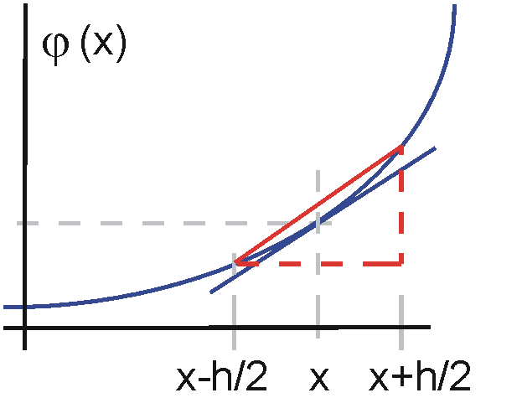
Maxwell: finite differences
One dimension:

Slide 17
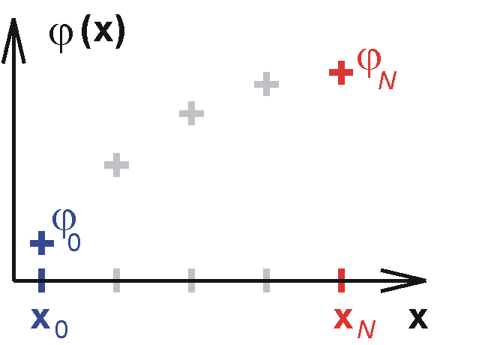
Maxwell: finite differences

Slide 18
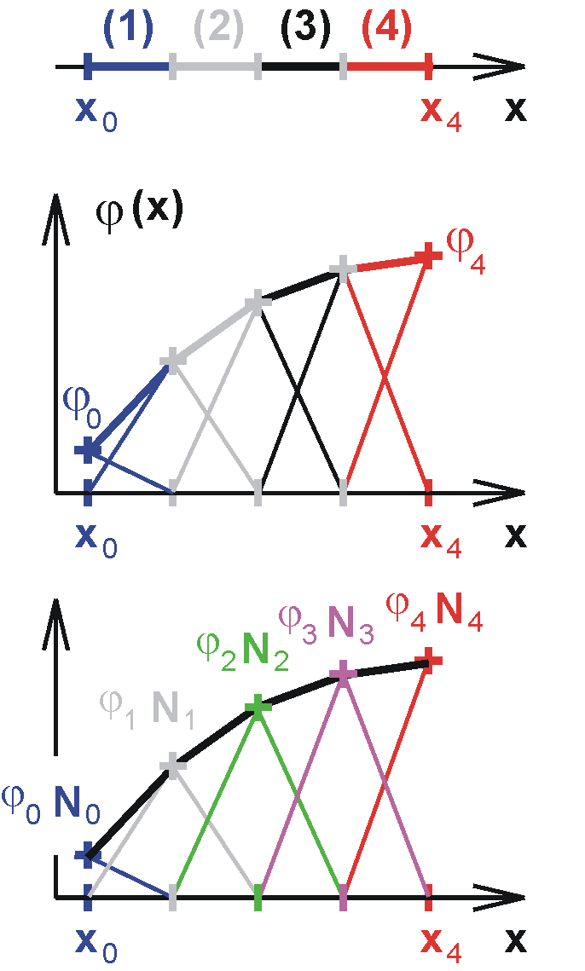
Maxwell: finite elements
Formal approximation of unknown quantity
Substituting to solved equation

Slide 19
Maxwell: finite elements
Residuum minimization:
Galerkin method:

Slide 20
Maxwell: finite elements
S_{mn}
T_{mn}
Weighting all nodes with the unknown value E_{n}

Slide 21
Maxwell: finite elements
1. Structure decomposed to isolated elements:
2. Tabulated matrices for normalized elements:

Slide 22
Maxwell: finite elements
3. Matrices for isolated elements:

Slide 23
Maxwell: finite elements
4. Coupling matrix:

Slide 24
Maxwell: finite elements
5. Coupling of isolated elements:
6. Boundary conditions, matrix equation:

Slide 25
Summary
Description of wave phenomena by Maxwell equations in the differential form
Finite differences: solution represented by nodal values CST
Finite elements: solution represented by a polynomial approximation HFSS

