Slide 1


Modeling Wave Propagation:
On-body & In-body Communication
Body-centric wireless communication
Zbyněk Raida
raida@vut.cz
Vytvořeno za podpory projektu OP VVV Moderní a otevřené studium techniky CZ.02.2.69/0.0/0.0/16_015/0002430

Slide 2

Recap
Why phantoms are exploited?
What kinds of phantoms are known,
and when are they used?
How the specific absorption rate (SAR) is defined,
and what are the admissible limits?
How does the layered phantom look like?
How do its parameters vary with frequency?
Why phantoms have to be calibrated and
what is the calibration procedure?

Slide 3
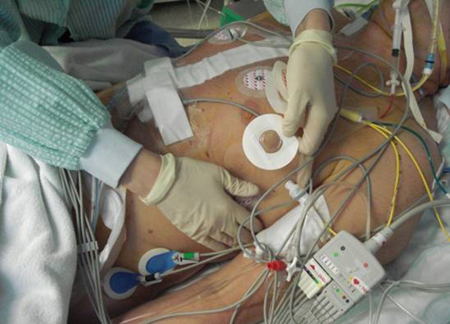
Wired × wireless communication
Can be human body represented by a conductive ground plane?

Slide 4
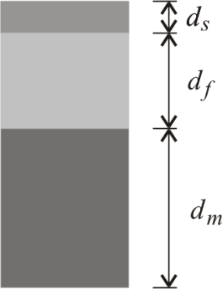
Tissue parameters
 | d [mm]
Skin | 2
Fat | 10
Muscle | 28
2.4 GHz | ε_{r} [-] | σ [S/m]
Skin | 38.063 | 1.441
Fat | 5.285 | 0.102
Muscle | 52.791 | 1.705

Slide 5
Tissue parameters
5.8 GHz | ε_{r} [-] | σ [S/m]
Skin | 35.114 | 3.717
Fat | 4.955 | 0.293
Muscle | 48.485 | 4.962
60 GHz | ε_{r} [-] | σ [S/m]
Skin | 7.975 | 36.39
Fat | 3.132 | 2.815
Muscle | 12.856 | 52.82

Slide 6
Wired communication
Immunity against interferences
High efficiency
  Propagation of EM energy in a single direction
  Losses in dielectrics
  Losses in inner conductor and shielding
Applicable in case of on-body communication only

Slide 7
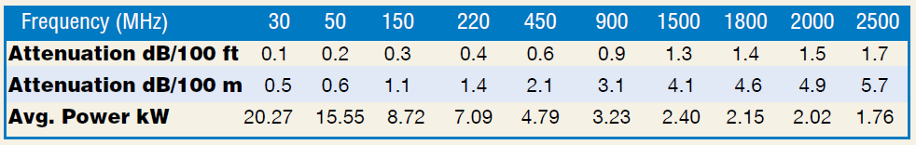
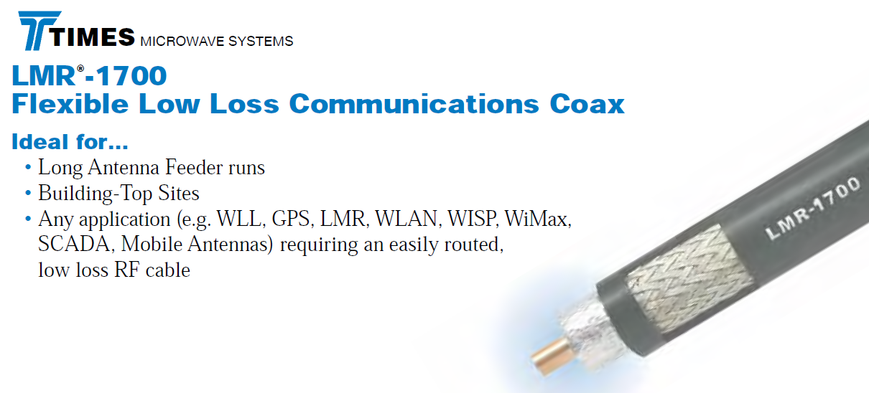
Wired communication

Slide 8
Wireless communication
High mobility
High sensitivity to interferences
Low efficiency
  Energy propagation in all directions
  Losses in surrounding (tissues heated)
  Losses in an antenna
Necessary when communicating in a body
or off a body

Slide 9
Contents
Efficiency of wireless communication
Off-body communication
free-space propagation (air)
In-body communication
wave propagation in a lossy environment (inhomogeneous)
On-body communication
wave propagation along the interface of a lossy environment and the air

Slide 10
Efficiency
Coaxial line: −6 dB / 100 m → P₂ = 0.25 P₁
Free space: Friis equation
Reception and transmission by half-wavelength dipoles (gain G = 1.64), frequency f = 2.0 GHz and the distance R = 100 m

Slide 11
Efficiency
Symmetric dipole:
−75 dB / 100 m → P₂ = 10⁻⁸ P₁
Transmission:
P₂ = 10⁻¹ P₁
effective
aperture
surface of
wavefront

Slide 12
Off-body propagation
Propagation in a half-space → reflector
Forward and reflected wave in phase:
→ E_{tot} = 2E → P_{tot} = +6 dB

Slide 13
Off-body propagation
Wave equations
where

Slide 14
Off-body propagation
In general:
attenuation constant
phase constant

Slide 15
Off-body propagation [vacuum]
Negligible losses

Slide 16
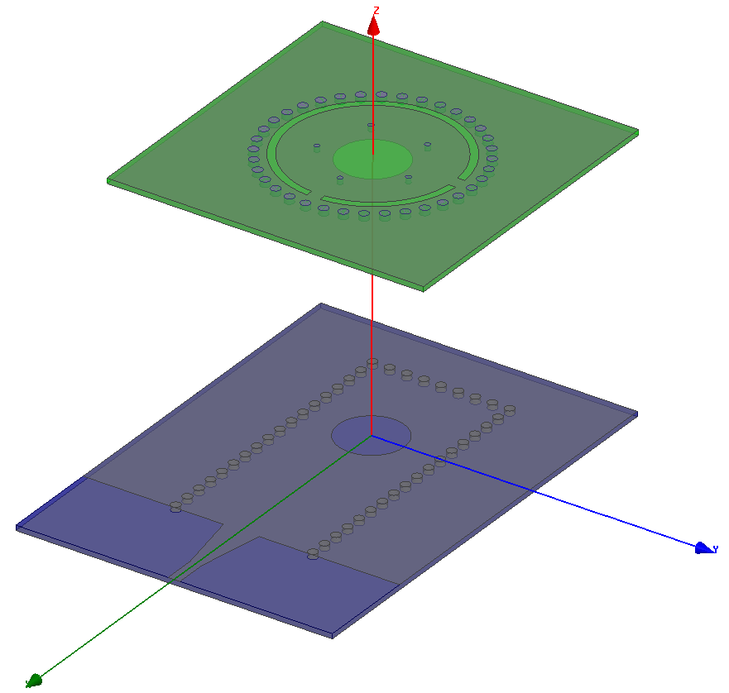
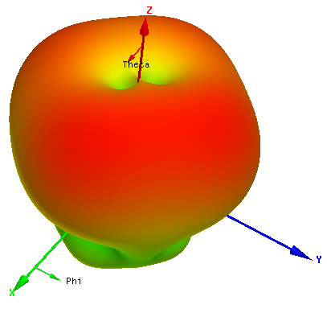
An example: magnetic loop
Gain Theta
LÁČÍK, J. Circularly polarized SIW square ring-slot antenna for X-band applications, Microwave and Optical Technology Letters, 2012, vol. 54, no. 11, p. 2590-2594.

Slide 17
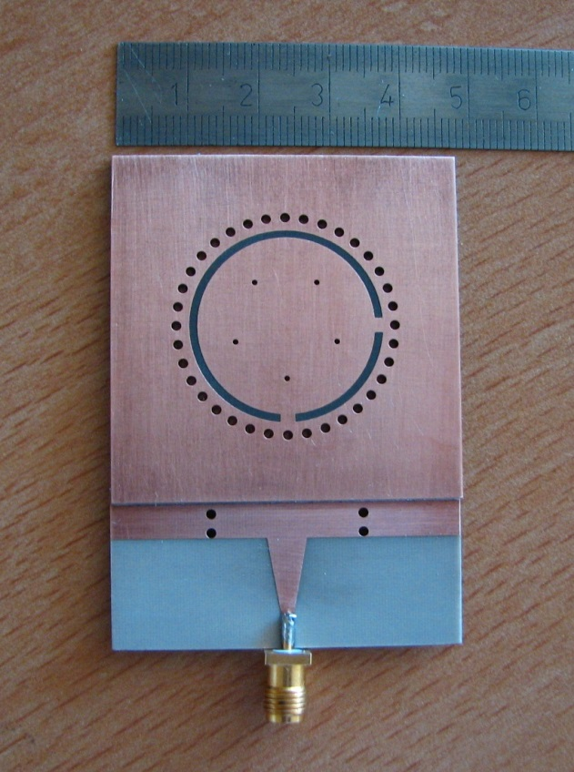
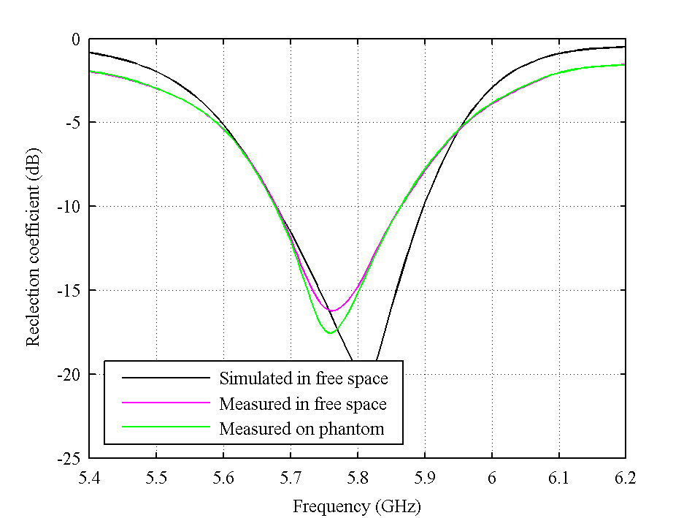
An example: magnetic loop
Fabricated antenna
Reflection coefficient
Reflection coefficient (dB)
LÁČÍK, J. Circularly polarized SIW square ring-slot antenna for X-band applications, Microwave and Optical Technology Letters, 2012, vol. 54, no. 11, p. 2590-2594.

Slide 18
In-body propagation [dielectrics]
phase velocity
wavelength
power density
wave
impedance

Slide 19
An example: wireless endoscopy
Sensor capsule in digestive tract,
receive antenna on body surface
SUZAS MIAH, Md., et al. Antenna system design for improved wireless capsule endoscope links at 433 MHz. IEEE Transactions on Antennas and Propagation, 2019, vol. 67, no. 4, p. 2687-2699.

Slide 20
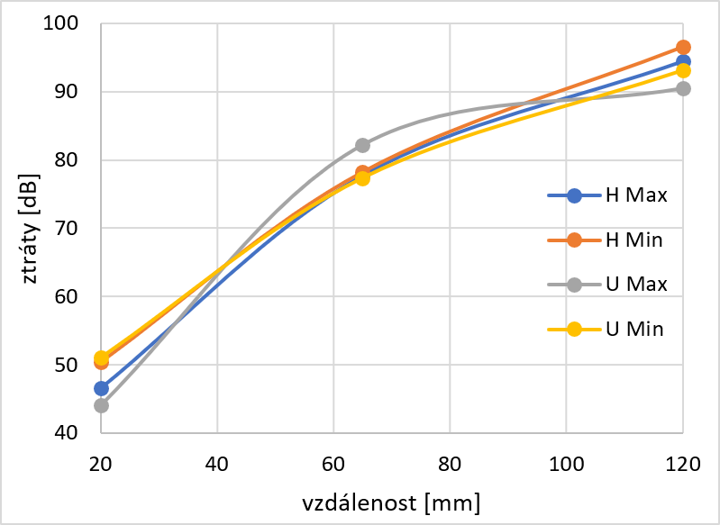
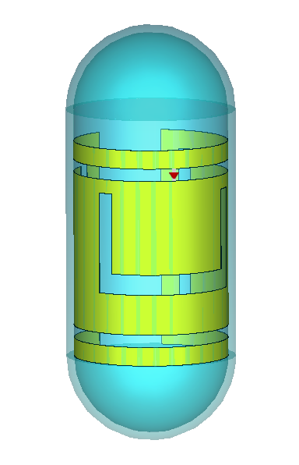
An example: wireless endoscopy
f₁ = 433 MHz → f₂ = 2.4 GHz
RAŠKA, M. Sensing the sensor signal in digestive tract. Bachelor thesis. Brno University of Technology, 2019.

Slide 21
On-body propagation
On-body communication
EM energy radiated into a half-space:
→ half value of radiation resistance → P_{tot} = +3 dB

Slide 22
On-body propagation
Perfect electric conductor (PEC) → lossy dielectrics
Norton wave
direct
reflected
space
wave
J. C. Jordan, K. G. Balmain, Electromagnetic Waves and
Radiating Systems, Englewood Cliffs: Prentice Hall, 1968.

Slide 23
On-body propagation
Vertically polarized surface wave
distance between antennas
kde
wave number
numeric distance
complex permittivity

Slide 24
On-body propagation
Attenuation function
Approximation for p > 20
where

Slide 25
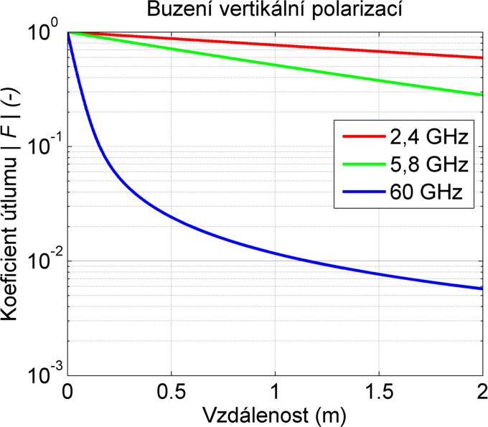
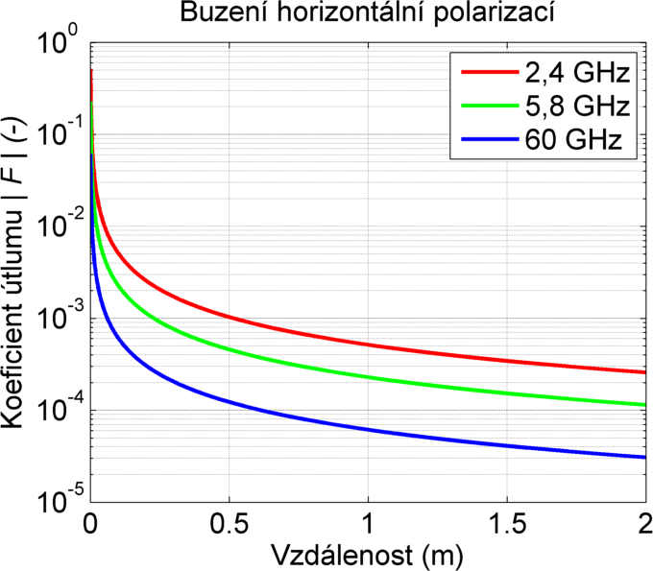
On-body propagation

Slide 26
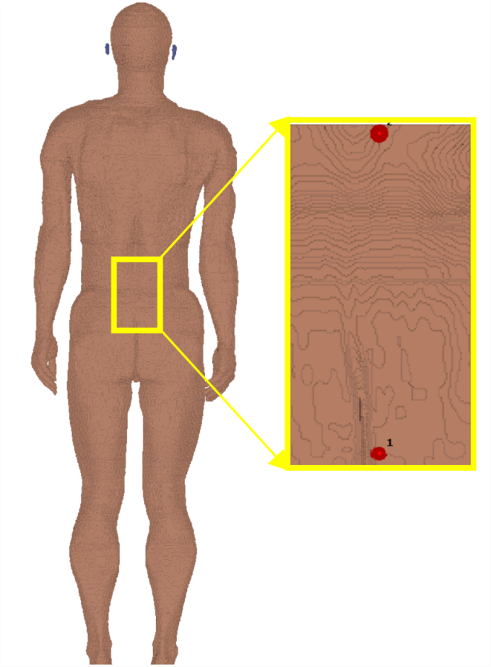
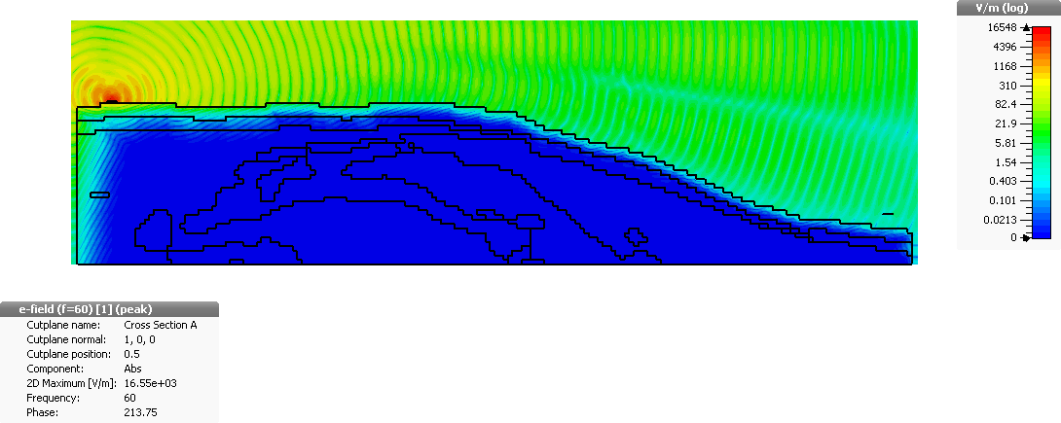
ISM band 60 GHz
planar equivalent phantom
comprising diffraction

Slide 27
Phantom 60 GHz
Reflection coefficient at the input
of quarter-wavelength monopole

Slide 28
Phantom 60 GHz
Tuning parameters [ε, σ] of Norton model:
comparison of transmission coefficient with voxel model

Slide 29
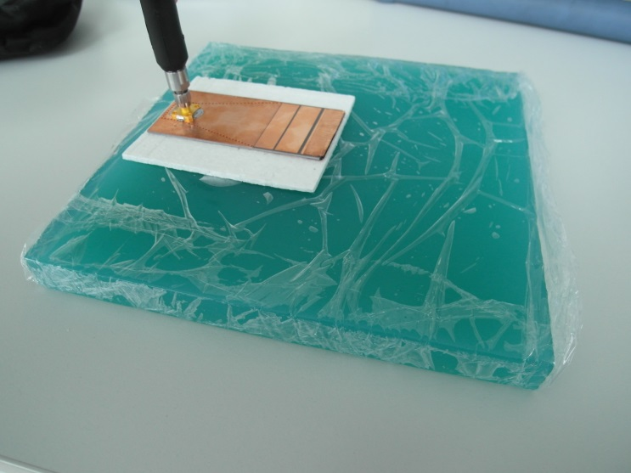
An example: horn antenna
CUPAL, M.; RAIDA, Z. H-plane SIW horn antenna for on-body communication. Radioelektronika 2016. Košice (Slovakia): IEEE. DOI: 10.1109/RADIOELEK.2016.7477347

Slide 30
An example: horn antenna
CUPAL, M.; RAIDA, Z. H-plane SIW horn antenna for on-body communication. Radioelektronika 2016. Košice (Slovakia): IEEE. DOI: 10.1109/RADIOELEK.2016.7477347

Slide 31
An example: horn antenna
CUPAL, M.; RAIDA, Z. H-plane SIW horn antenna for on-body communication. Radioelektronika 2016. Košice (Slovakia): IEEE. DOI: 10.1109/RADIOELEK.2016.7477347

Slide 32
Summary
Wired versus wireless communication:
the problem of efficiency
Electrical parameters of human body:
in-body / off-body / on-body wave propagation
On-body communication:
Norton wave
Increasing frequency → the increase of attenuation

