Slide 1


Wearable Electronics:
Global & Multi-Objective Optimization
Body-centric wireless communication
Zbyněk Raida
raida@vut.cz
Vytvořeno za podpory projektu OP VVV Moderní a otevřené studium techniky CZ.02.2.69/0.0/0.0/16_015/0002430

Slide 2

Recap
Single-objective optimization
- objectives weighted and summed
Surrogate model
- proper selection of state variables
Searching for minimum
- steepest descent × Newton × quasi-Newton
Constrained optimization
- reduction of feasible space

Slide 3
Contents
Global optimization
- genetic algorithms: use of evolutionary principles
- swarm optimization: intelligence of swarms
Multi-objective optimization
- Pareto front of optimal solutions

Slide 4
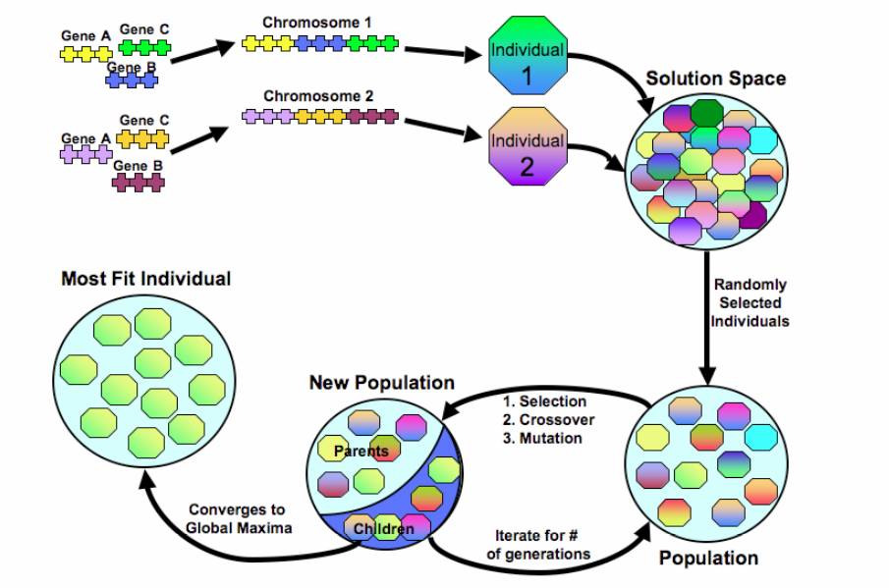
Genetic (evolutionary) optimization
JOHNSON, J. M., RAHMAT-SAMII, Y. Genetic algorithms in engineering electromagnetics. IEEE Antennas and Propagation Magazine. 1997, vol. 39, no. 4, p. 7–25.

Slide 5
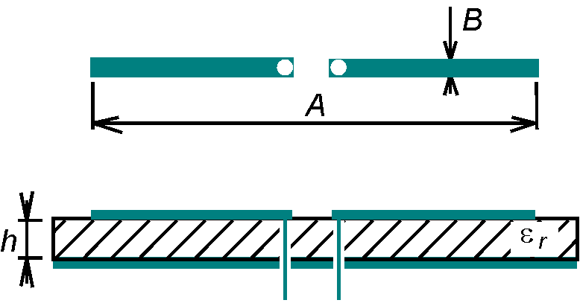
Evolutionary optimization: antenna

Slide 6
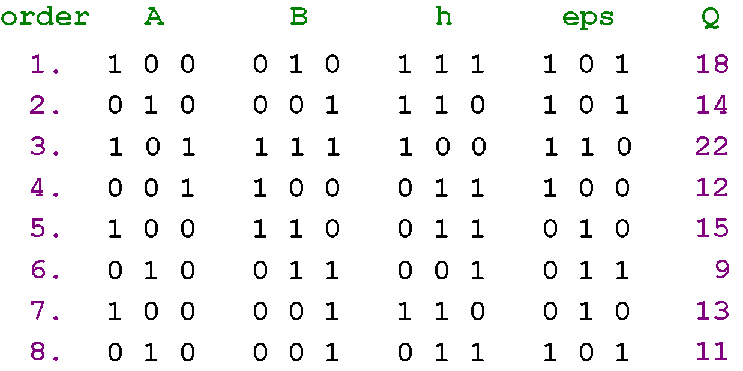
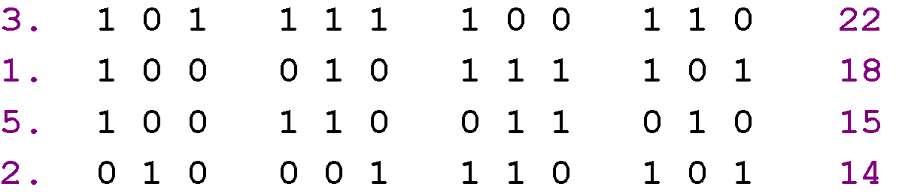
Evolutionary optimization: antenna
initial population
quality evaluation
selection

Slide 7
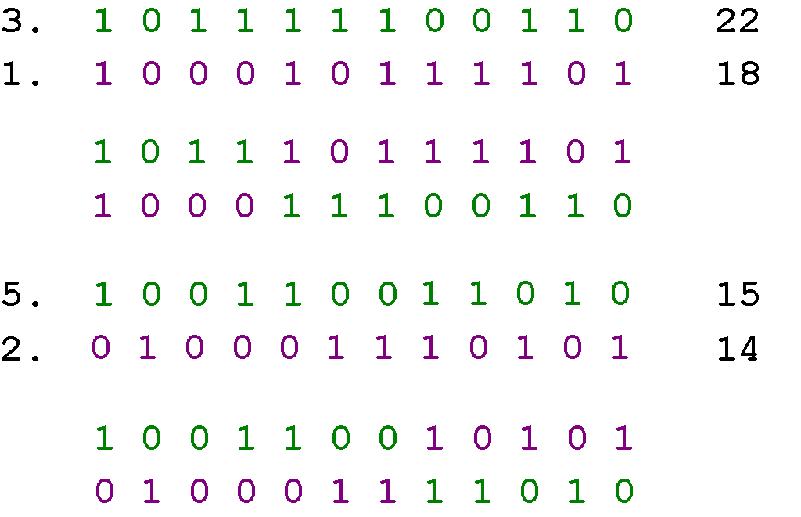
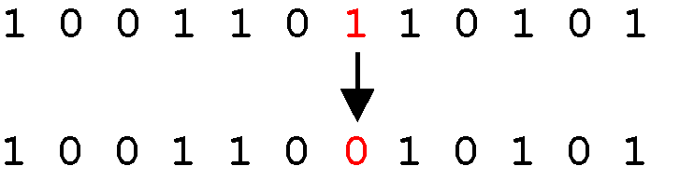
Evolutionary optimization: antenna
crossover
mutation

Slide 8
Evolutionary optimization: antenna
elitism
monotonous decrease
of objective function

Slide 9
Evolutionary optimization: antenna

Slide 10
Evolutionary design: filter

Slide 11
Evolutionary design: monopole

Slide 12
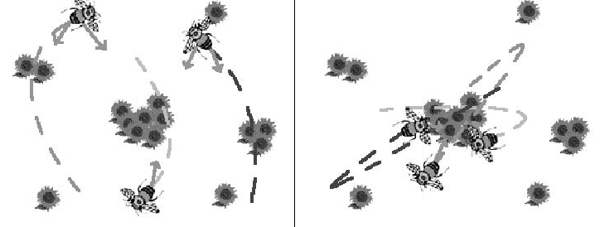
Swarm intelligence
ROBINSON, J., RAHMAT-SAMII, Y. Particle swarm optimization in electromagnetics. IEEE Transactions on Antennas and Propagation. 2004, vol. 52, no. 2, p. 397–407.

Slide 13
Swarm intelligence

Slide 14
Swarm intelligence
absorbing
reflecting
invisible

Slide 15
function out = main( G, I)
% x(1)= A, x(2)= B, x(3)= h, x(4)= eps
load dip_616; % loading antenna model
Rd = 200; % required input resistance
Xd = 0; % required input reactance
dt = 0.1; % time step
c1 = 1.49; % personal scaling factor
c2 = 1.49; % global scaling factor
x = zeros( I, 5); % agents’ position
p = zeros( I, 5); % personal best
for n=1:I
x(n,1) = 1.000 + 8.000*rand(); p(n,1) = x(n,1);
x(n,2) = 0.001 + 0.049*rand(); p(n,2) = x(n,2);
x(n,3) = 1.0 + 0.5 * rand(); p(n,3) = x(n,3);
x(n,4) = 1.0 + 1.2 * rand(); p(n,4) = x(n,4);
p(n,5) = 1e+6;
end
v = rand( I, 4); % agent velocity
g = zeros( 1, 4); % global best
e = zeros( G+1, 1); e(1) = 1e+6;

Slide 16
for m=1:G % +++ MAIN ITERATION LOOP +++
w = 0.5*(G-m)/G + 0.4; % inertial weight
Z = Tmax * sim( net, x(:,1:4)'); % impedance of agents
x(:,5) = ((Rd-Z(1,:)).^2 + (Xd-Z(2,:)).^2
[e(m+1),ind] = min( x( :,5)); % the lowest error
if e(m+1)<e(m)
g = x( ind, 1:4); % the global best
end
for n=1:I
if x(n,5)<p(n,5) % the personal best
p(n,:) = x(n,:);
end
v(n,:) = w*v(n,:) + c1*rand()*( p(n,1:4)-x(n,1:4));
v(n,:) = v(n,:) + c2*rand()*( g(1,1:4)-x(n,1:4));
x(n,1:4) = x(n,1:4) + dt*v(n,:);
if x(n,1) > 9.00, x(n,1)=9.00; end % absorbing walls
if x(n,2) > 0.05, x(n,2)=0.05; end
if x(n,3) > 1.5, x(n,3)=1.5; end
if x(n,4) > 2.2, x(n,4)=2.2; end
end
end

Slide 17
Swarm intelligence

Slide 18
Swarm intelligence

Slide 19
Summary
Physical models not required
Novel structures can be developed
potentially
High memory and CPU-time demands

Slide 20
Multi-objective optimization
Non-conflicting objectives:
single-objective optimization
objective
function
energy
energy
weighting
coefficient
weighting
coefficient

Slide 21
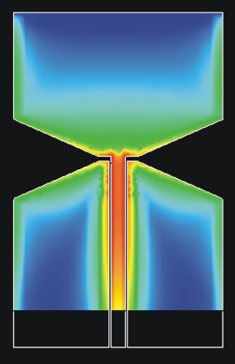
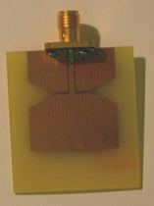
Multi-objective optimization
Non-conflicting objectives
F
l

Slide 22
Multi-objective optimization
Non-conflicting objectives
F
w₁ = 1, w₂ = 2
w₁ = 1, w₂ = 1
l

Slide 23
Additional objectives
For frequencies f₁, f₂, … , f_{N}
- Circular polarization AR(x, f )
- Minimum substrate area S(x, f )
- Etc.

Slide 24
Multi-objective optimization
Conflicting objective:
F
l

Slide 25
Multi-objective optimization
Pareto front of optimal solutions
F₃
F₁

Slide 26
Summary
Global optimization
(evolutionary × swarm intelligence)
Random generation of initial set
Quality evaluation of set members
[higher quality → stronger influence on next set]
Creating better generation of successors
Go to step 2

Slide 27
Summary
Multi-objective optimization
Non-conflicting objectives:
weighted partial objectives summed
Conflicting objectives:
Pareto set of optimal solutions

