Slide 1
Wireless Body-centric Area Networks: Examples
Body-centric wireless communication
Zbyněk Raida
raida@vut.cz
Vytvořeno za podpory projektu OP VVV Moderní a otevřené studium techniky CZ.02.2.69/0.0/0.0/16_015/0002430

Slide 2
Example #1
Bluetooth-based Wireless Body Area Network (WBAN)
The 24th International Traveling Summer School on Microwaves and Lightwaves
Copenhagen (Denmark), July 2014
Jan Velim, Brno University of Technology Leonardo Di Alessandro, Tor Vergata University, Rome Tomasz Karpisz, Warsaw University of Technology José Estarán, Technical University of Denmark

Slide 3
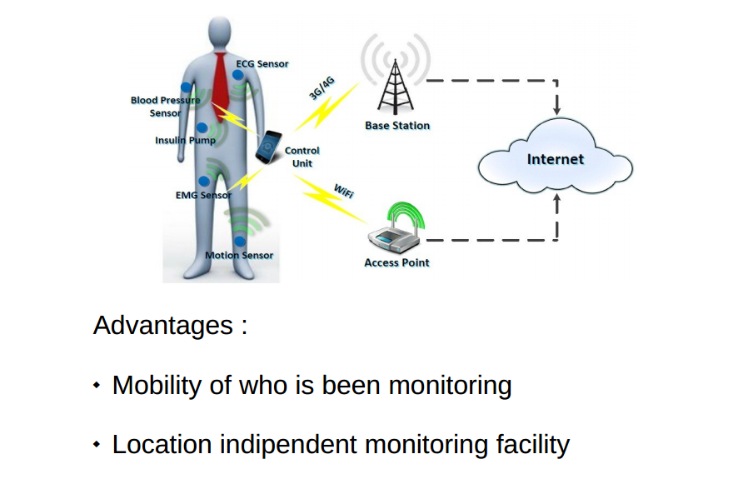
WBAN

Slide 4
WBAN

Slide 5
WBAN
Wireless Body Area Network (WBAN) - ISM regulations (2.4 GHz × 5.8 GHz band) - Sensors, central unit and remote node - Medical / sport applications

Slide 6
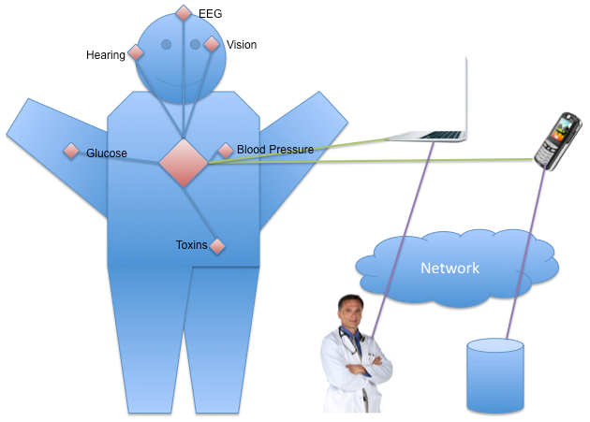
WBAN
Design challenges: - Central unit - Sensing network - Antenna - Interfacing the remote node - Power feeding

Slide 7
Case analysis
Reliable - Single central unit (CU) ensures the proper function of the network
Scalable / flexible - Complex network design (interfacing CU and remote node)
Cheap - Wireless link with intermediate access / interface

Slide 8
Case analysis
Low power consumption - Power-efficient data communication protocols
Compatible with remote devices - ISM frequency bands preferred
Minimum number of invasive elements - Ideally, only the on-body sensors (epidermal electronics)

Slide 9
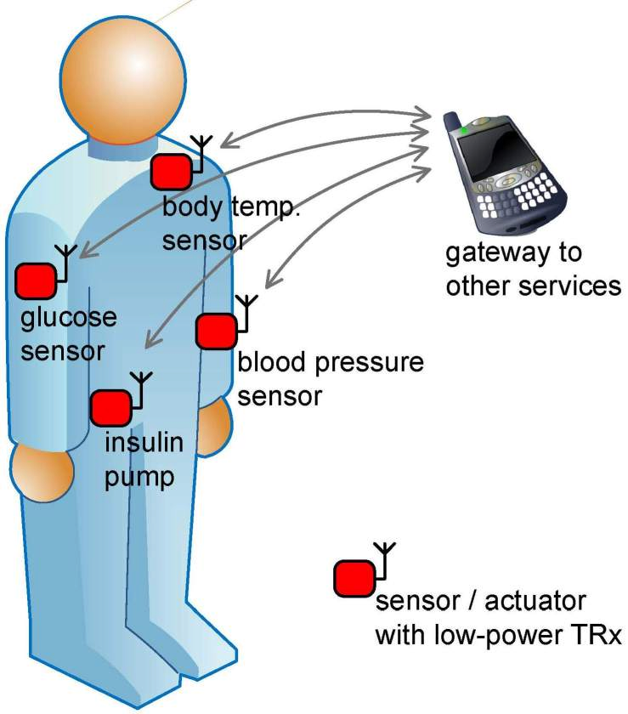
The system
Optimum 10 m reach at 1 Mbps
Low power consumption <15 mA
Point-multipoint (max 7 devices)
Automatic synchronization
Cheap and rapid implementation
ISM band 2.4 GHz with 100 MHz modulation BW

Slide 10
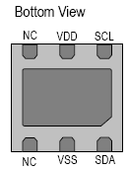
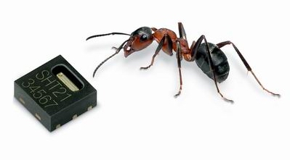
Sensors
Humidity: STN21
Supply Voltage, VDD
3 V
0.5 µW (sleep mode)
Power Dissipation
0.9 mW (measuring)
Operatin range
0 – 100 % RH
Output
I2C, 12 bit, 8 bit
Price
cca 3.5 €

Slide 11
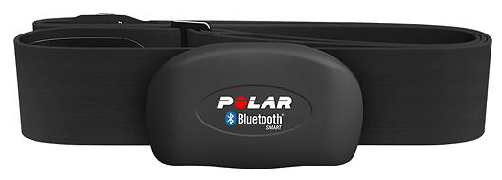
Sensors
Heart rate: Polar H7
Supply Voltage, VDD
3 V
Battery lifetime
200 h
Communication
Bluetooth
Price
cca 50 €

Slide 12
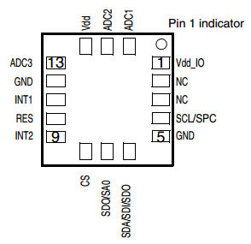
Sensors
Accelerometer: LIS3DH
Supply Voltage, VDD
3 V
11 mA (norm. mode)
Current consumption
6 mA (Low P. mode)
Output
I2C
Price
cca 1 €
± (2, 4, 8, 16) g dynamically selectable full scale

Slide 13
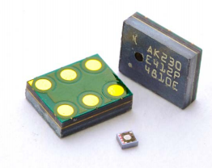
Sensors
Microphone: AKU230
Supply Voltage, VDD
3 V
1.2 mA (normal mode)
Current consumption
11 µA (low power mode)
Frequency Range
50 Hz – 22 kHz
Signal to Noise Ratio
56 dB
Sensitivity
-26 dBFS

Slide 14
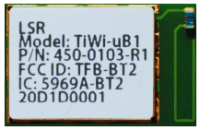
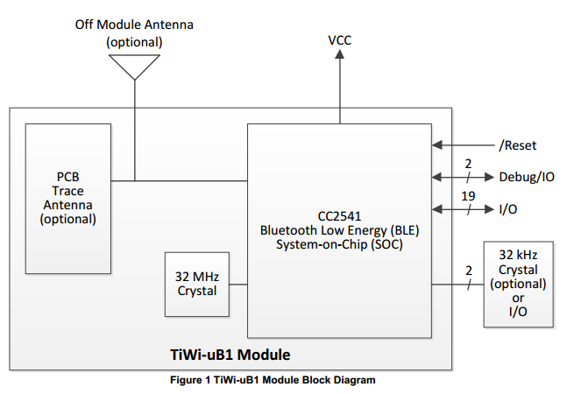
Transceiver
TiWi: uB1
Supply Voltage, VDD
3 V
Current consumption
12.6 mA (Trans.)
15.7 mA (Receiv.)
Interface
I2C
Transmit Power
0 dBm
Receiver Power
-94 dBm
Price
cca 10 €

Slide 15
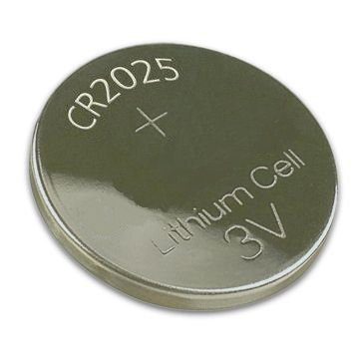
Power Supply
Button battery: CR2025
Nominal Voltage
3 V
Nominal Capacity
160 mAh
Average weight
2.4 grams
Price
cca 1 €

Slide 16
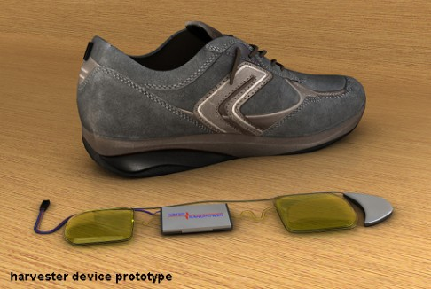
Power Supply
Shoe generator
Available Power
Upto 20 W
Transmit Energy
Bluetooth
Principle
Electroswetting
Price
cca ?? €

Slide 17
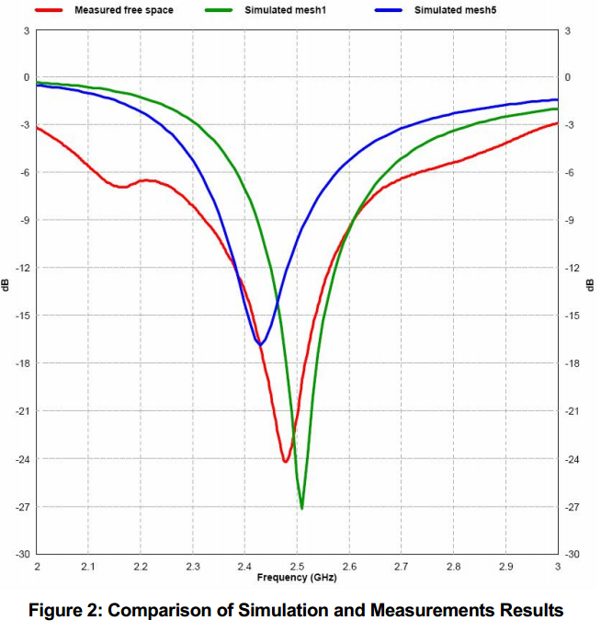
Antenna
PCB antenna
2.4 GHz / 100 MHz BW
Matched at 50 Ω
Size: 15.2 × 5.7 mm

Slide 18
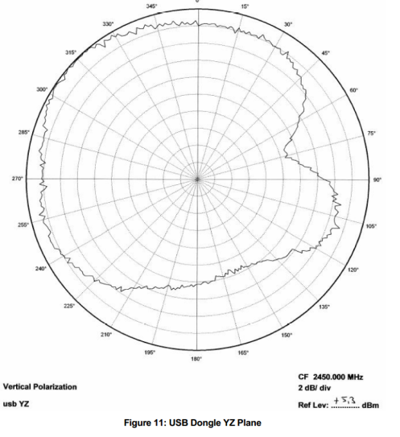
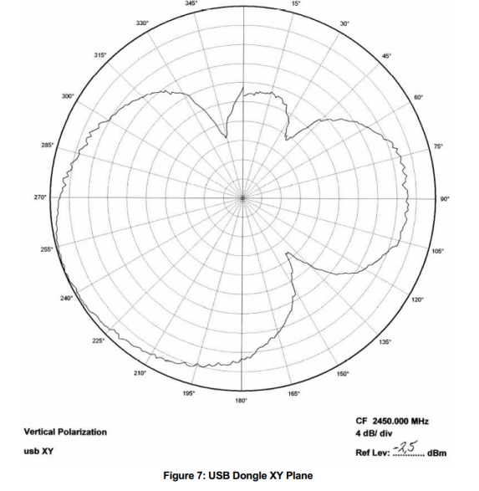
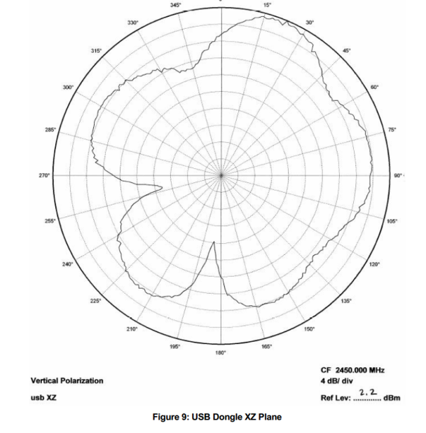
Antenna
PCB antenna
Audun Andersen, Small size 2.4 GHz PCB antenna, Application Notes, AN043.

Slide 19
Summary
Simple WBAN composed from commercially available components equipped with Bluetooth interface
Low price
Easy to develop, easy to use
Customizable: sensors to be selected on demand

Slide 20
Example #2
Wireless Body Area Network (WBAN) for Animals
The 25th International Traveling Summer School on Microwaves and Lightwaves
Madrid (Spain), July 2015
Luca Liberati, University of L'Aquila Vytautas Jakstas, Center for Physical Science & Technol. Till Mohr, Technische Universität Darmstadt Mahsa Ebrahimpouri, KTH Stockholm

Slide 21
Motivation
Losses of cows in the UK caused by diseases:
4.5 million incinerated due to bovine spongiform encephalopathy in 1986;
4.0 million slaughtered due to foot and mouth disease;
In total, economic losses ≈13 billion ₤.

Slide 22
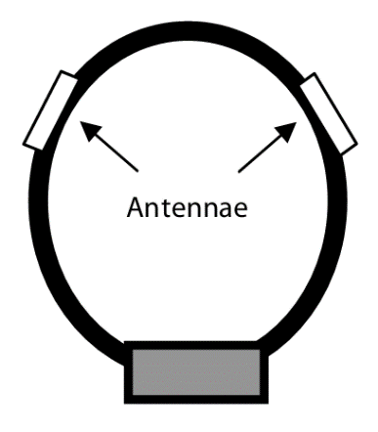
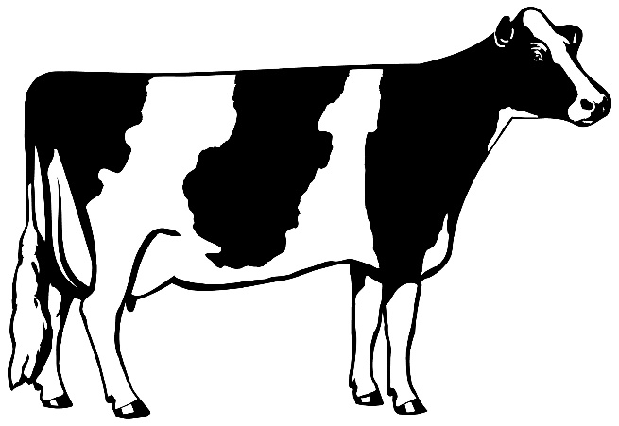
Motivation
Detect diseases at an early stage
Additional: reduction in the required amount of medicine.

Slide 23
Requirements
Cheap
Comfortable
Reliable
Easy to mount and use
Long-life time
Weather resistant (waterproof etc.)
Self powering
Weak back radiation of antennas

Slide 24
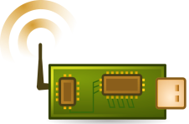
Concept
Several sensors attached to animal body
Each sensor transmits data to base unit
Base unit stores data
Reaching the feeding place, the base unit transmit data to computer.

Slide 25
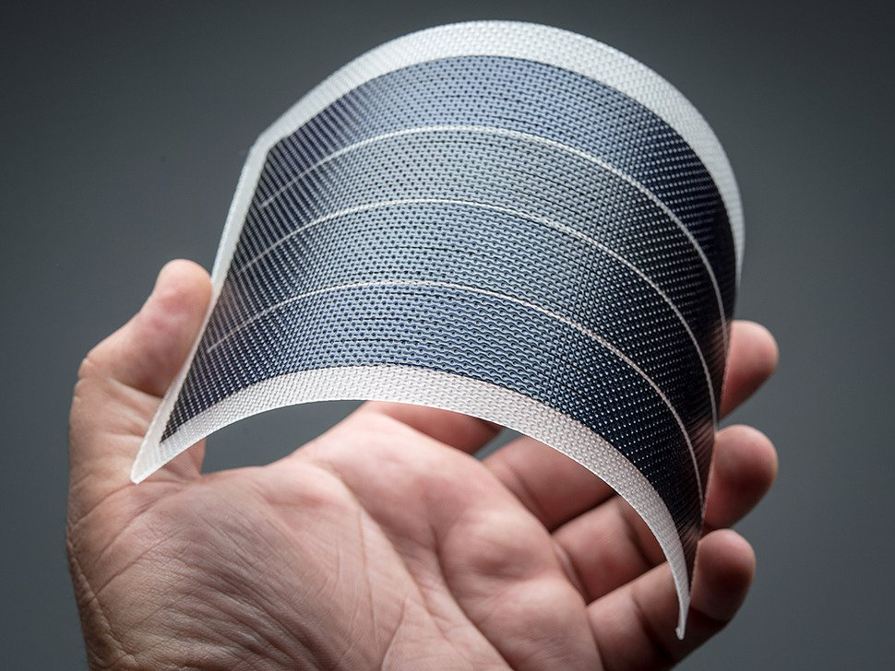
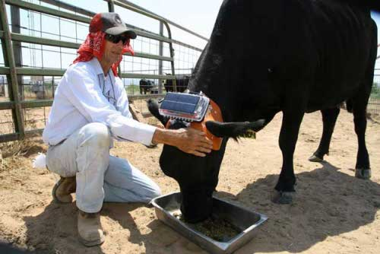
Energy harvesting
Solar cell
Integrated into animal’s belt.
Powering energy extensive sensors and communication systems.
Flexible solar cells provide up to 1 W (size 10 x 19.8 cm)

Slide 26
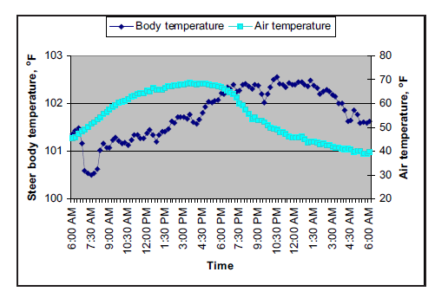
Energy harvesting
Pyroelectric source
Pyroelectric energy harvesting needs change of temperature.
The temperature of cow changes over ≈1°C.
An average harvesting: 1µW/cm² on 100 µm thick device.
Steer body temperature measured every 15 minutes during a warm day
[1] R. H. Watson, Georgia Automated Environmental Monitoring Network, The University of Georgia, USA
[2] G. Sebald et al., Smart Material Structures, 18 (2009)

Slide 27
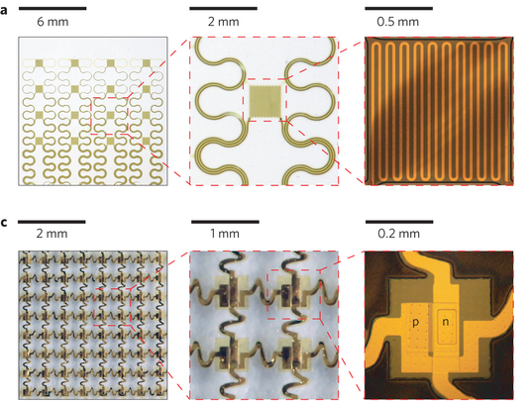
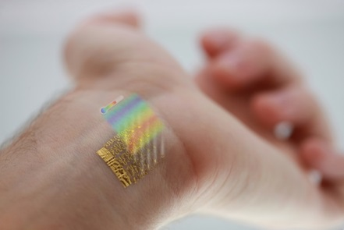
Sensors
Body temperature
[1] R. Ch. Webb, Nature Materials 12, 938–944 (2013)

Slide 28
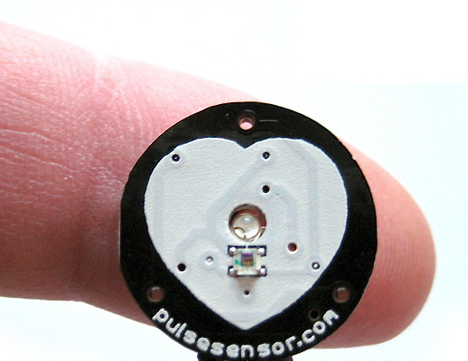
Sensors
Heart beating
Commercially available
Open source hardware
Small size

Slide 29
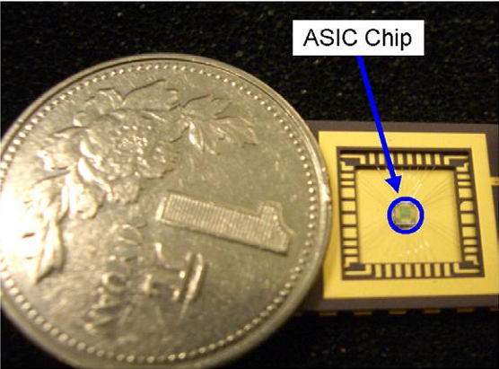
Sensors
Blood pressure
Uses cheap LED & PD

Slide 30
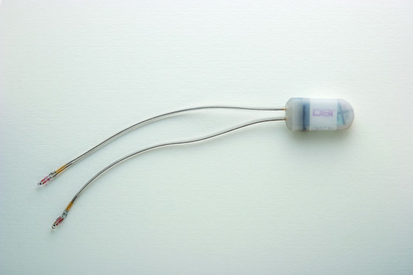
Sensors
Breathing
Simple thermistor attached to nose stud [1]
Exhaling changes the temperature
[1] http://www.datasci.com

Slide 31
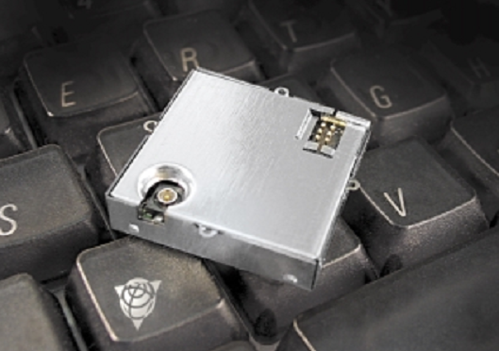
Sensors
Movement (GPS)
Attached to base unit.
Commercially available
Quick on/off to save energy
[1] http://www.trimble.com

Slide 32
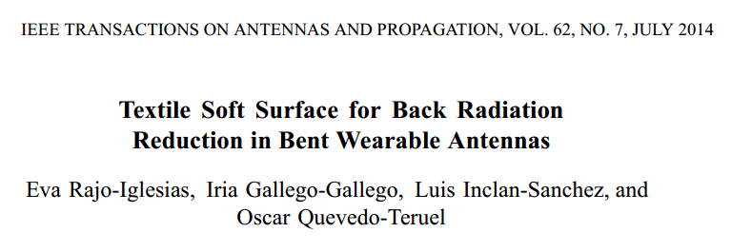
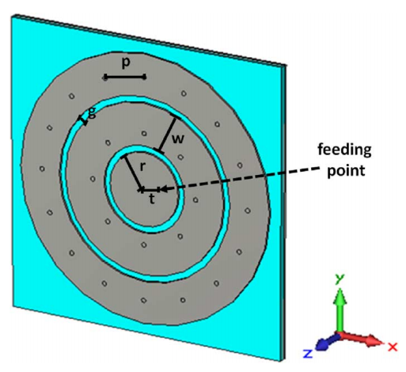
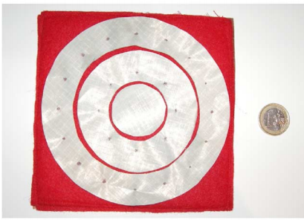
Antennas

Slide 33
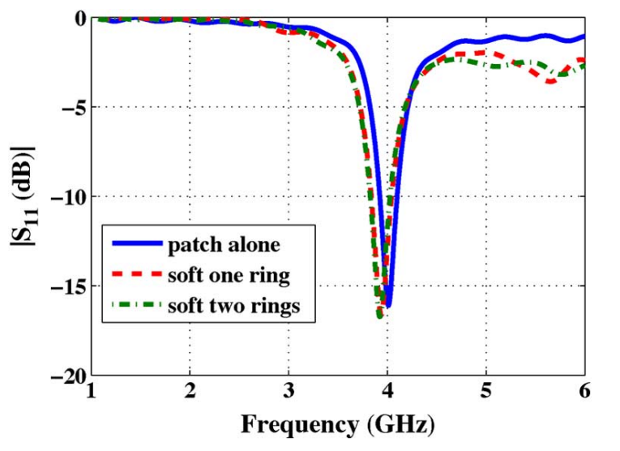
Antennas
Impedance matching

Slide 34
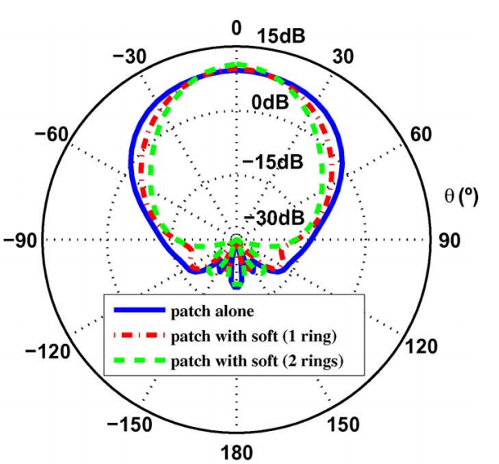
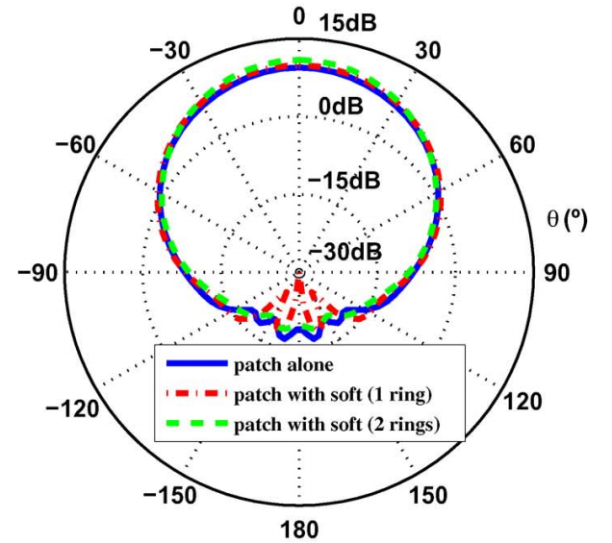
Antennas
Radiation patterns

Slide 35
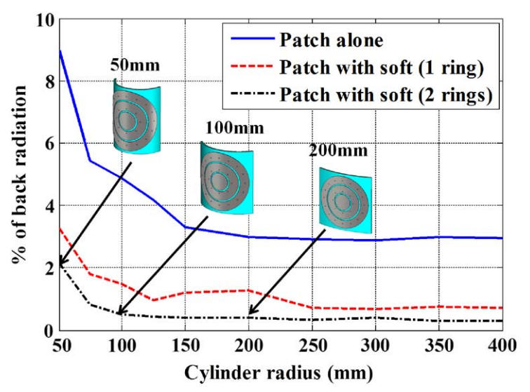
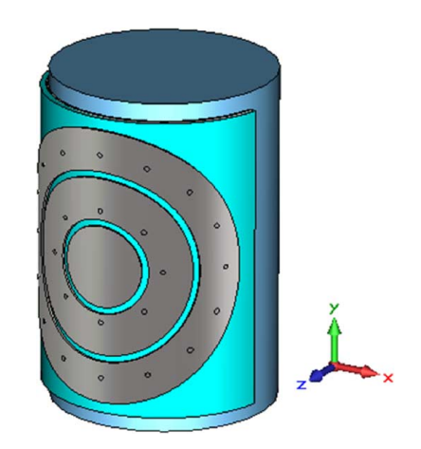
Antennas
Back radiation

Slide 36
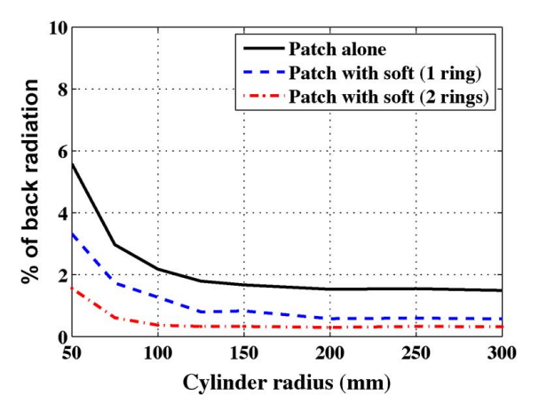
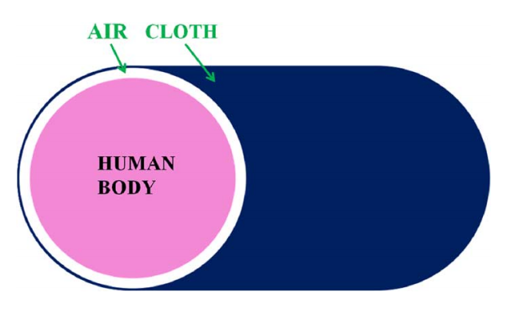
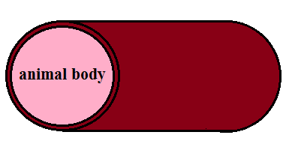
Antennas
Body effect
animal fur

Slide 37
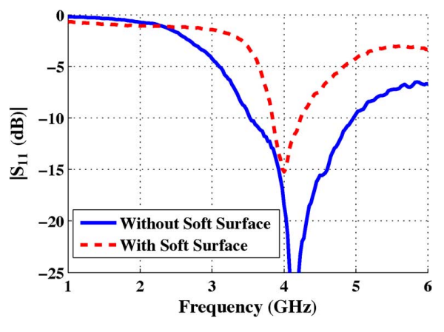
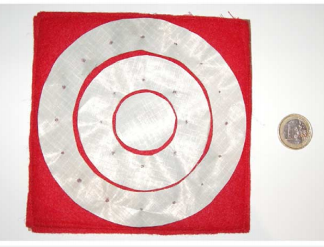
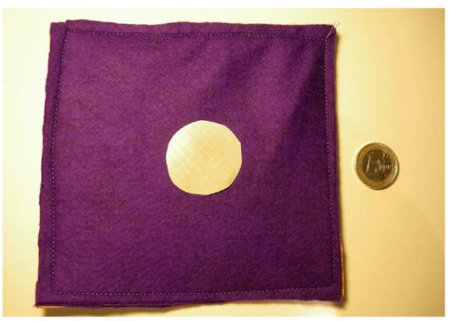
Antennas
Experimental results

Slide 38
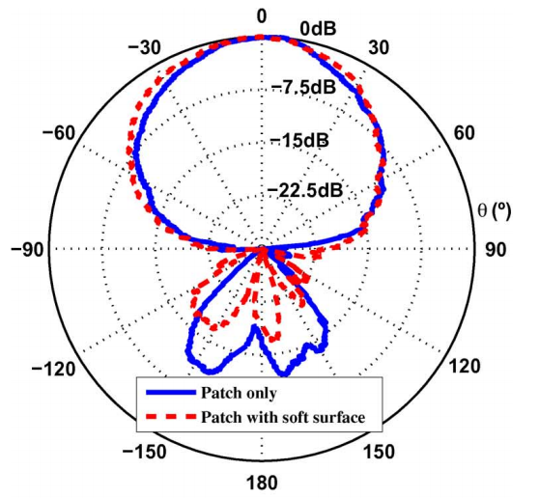
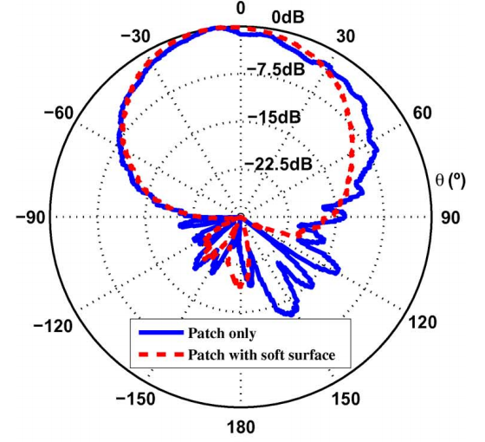
Antennas
Experimental results
flat antenna
curved antenna (r = 100 mm)

Slide 39
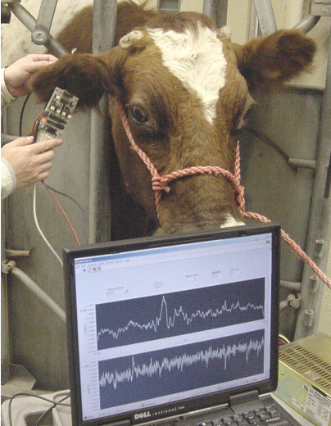
Summary
Autonomous cow healthcare monitoring
Energy harvesting by solar cells and pyroelectrics
Sensing temperature, heart-beat, blood pressure, breathing
Off-body communication by circular patch antenna

